Slide 1
MAKING IT COUNT
cerespolicyresearch
Collecting SOGIE data to improve outcomes for system-involved youth
Angela Irvine, Ph.D.
Aisha Canfield, MPP
September 10, 2019
Notes:
Slide Tips
This slide is up while the facilitators:
Thank the hosts and welcome the group.
Review basic meeting room logistics (wifi 411 & bathrooms)
Introduce themselves and their expertise in this issue
Frame why we are together, what SOGIE is and the days agenda

Slide 2
INTRODUCTIONS
Name/Pronoun
Position/CBO
Notes:
Slide Goals
Disarms participants who may feel that a lack of experience with the topics of LGBQ/GNCTI or SOGIE-related issues excludes their participation from adding value to the training and discussions.
Slide Tips
Model what you’re asking from participants prior to asking them to share.
If participants are having a difficult time identifying strength, provide some examples (number of years working with youth, lived experience as someone who is LGBQ/GNCTI or has a loved one who identifies as such)

Slide 3
SOGIE 101 LANGUAGE AND CONCEPTS
What is SOGIE?
Notes:
Notes about the definition slides that follow: Depending on how many questions were asked when you went over the vocabulary quiz, you can go more quickly or slowly to emphasize points that came up. You can speed up through the following slides if the audience seems like they already know the vocabulary.
Slide Goals
Introduce SOGIE in depth
Slide Tips
Ask participants to volunteer to share what SOGIE stands for
You can ask the audience for their reflections if they think the move to SOGIE from LGBT is a good or bad thing? You can ask the gender conforming and strait people in particular how they feel about it? The nature of being “closer” to LGBT people or defined within the same acronym .

Slide 4
SPECTRUMS EXERCISE
Notes:
Slide Tips
The purpose of this exercise is to reinforce and review SO, GI, and GE as spectrums.
Prior to jumping into the exercise, you can share the handout and model your own SOGIE and ask participants to do the same
Ask participants if you can tell someone’s sexual orientation by looking at them (if they say yes, ask what they are using to make those assumptions, chances are, they are confusing gender expression with sexual orientation)
Ask participants if you can tell someone’s gender identity by looking at them (the answer is no, this is an internal experience)
Ask participants if you can tell someone’s gender expression by looking at them (the answer is yes, this is the only identity that is visible, but is also subject to change and does not necessarily convey someone’s gender identity. For many reasons, namely safety, one may express gender in one way but internally identify with a different gender)
You can use a set of dice to then show that there are many different combinations of SOGIE. You can buy sets of white board dice online.

Slide 5
SOGIE 101 LANGUAGE AND CONCEPTS
LGBQ/GNCT Youth Quiz
Notes:
Slide Goals
The following slides present data on childhood development and pathways into the justice system for LGBT and GNC youth (of color)

Slide 6
QUIZ QUESTION 1
Everyone has a sexual orientation.
a) True
b) False
Notes:
Slide Goals
Normalize the breadth of sexual orientations a normal and healthy part of human development

Slide 7
QUIZ ANSWER 1
a) True. Everyone has a sexual orientation.
Notes:
Slide Tips
Questioning and asexual are also both considered sexual orientations

Slide 8
QUIZ QUESTION 2
Everyone has a gender identity.
a) True
b) False
Notes:
Slide Goals
Normalize the breadth of gender identities as a normal and healthy part of human development

Slide 9
QUIZ ANSWER 2
a) True. Everyone has a gender identity.
Notes:
Slide Tips
This also includes nonbinary, agender, and transgender individuals

Slide 10
QUIZ QUESTION 3
Children begin to become aware of their gender identity at around what age?
a) 2–4 years
b) 5–7 years
c) 8–10 years

Slide 11
QUIZ ANSWER 3
a) 2–4 years
Stephanie Brill and Rachel Pepper, 2008. The Transgender
Child: A Handbook for Families and Professionals
Notes:
Slide Tips
This is true both for transgender and cisgender youth. Children begin to display strong affinities or aversions to certain activities, items or clothing designated for one gender or another.
While youth begin to become aware of their gender, gender continues to evolve and develop over time.
Note – this does not mean that youth will or will not be transgender and is not an indication of a child’s sexual orientation.

Slide 12
QUIZ QUESTION 4
Children begin to become aware of their sexual orientation at around what age?
a) 8 years
b) 10 years
c) 12 years
Notes:
Slide Tips
Remind the group that this question is about feelings (first crushes) and not about sexual behaviors.

Slide 13
QUIZ ANSWER 4
10 years
Caitlin Ryan, et al., 2010. Family Acceptance in Adolescence and the Health of LGBT Young Adults
Notes:
You can remind your audience that this is an average and that, like gender, this evolves over time.

Slide 14
QUIZ QUESTION 5
Approximately ___ of homeless youth are LGBT nationwide.
a) 10%
b) 20%
c) 40%
Photo by Dimi Katsavaris on Unsplash
Notes:
Slide Goals
Begin illustrating the pathway into the justice system via other risk-factors that LGBTQ and GNC youth disproportionately experience

Slide 15
QUIZ ANSWER 5
Approximately 40% of homeless youth are LGBT.
Laura Durso & Gary Gates, 2012. Serving Our Youth: Findings from a National Survey of Service Providers Working with Lesbian, Gay, Bisexual, and Transgender Youth who are Homeless or At Risk of Becoming Homeless
Notes:
Slide Tips
Pause to get reflections from the group. This is an incredibly high number especially since LGBT youth only represent approximately 7% of the general population but are almost half of all homeless youth

Slide 16
QUIZ QUESTION 6
What percentage of youth in foster care are LGBTQ?
a) 19%
b) 29%
c) 39%
Notes:
Slide Goal
Present another data point and risk factor for system involvement

Slide 17
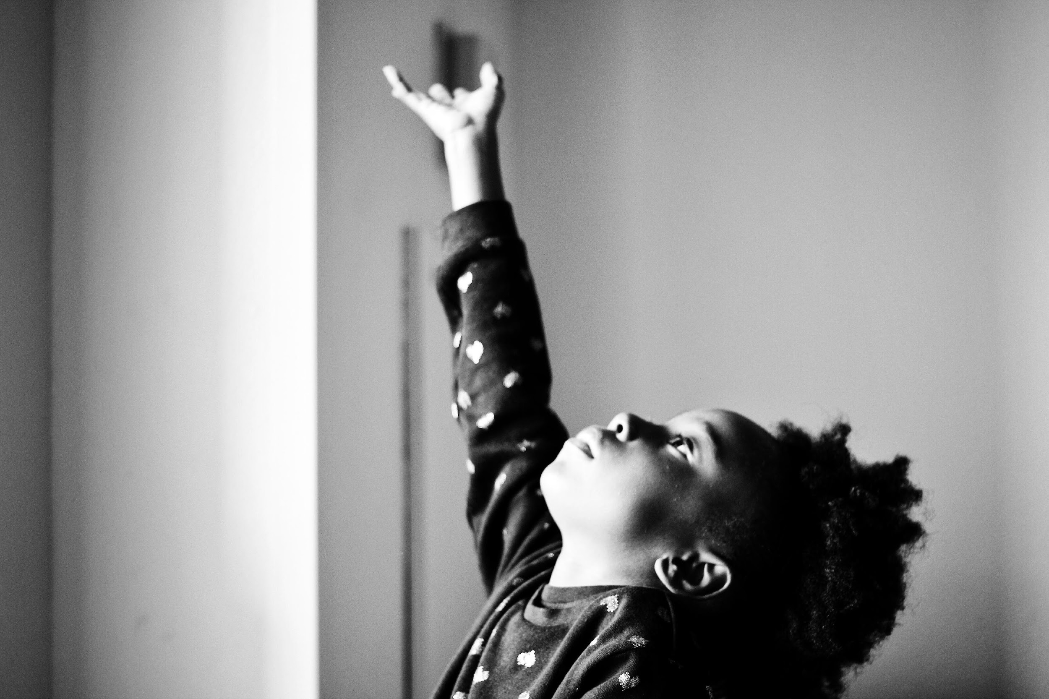
QUIZ ANSWER 6
19% of youth in foster care identify as LGBTQ.
Bianca Wilson, et al. 2014. Sexual and Gender Minority Youth in Foster Care: Assessing Disproportionality and Disparities in Los Angeles
Photo by Samantha Sophia on Unsplash
Notes:
Slide Tip
For additional discussion, mention that many LGBTQ youth are dually-involved in both the juvenile justice and child welfare systems

Slide 18
QUIZ QUESTION 7
What percentage of youth in detention facilities nationwide are lesbian, gay, bisexual, questioning or gender nonconforming and transgender?
a) 10 percent
b) 20 percent
c) 30 percent
Notes:
Slide Goals
Present the overrepresentation of LGBQ/GNCT youth in the juvenile justice system
Reinforce the importance of systematically collecting SOGIE data

Slide 19
QUIZ ANSWER 7
20% of youth in detention facilities nationwide are lesbian, gay, bisexual, questioning, or gender nonconforming.
Irvine, Angela, and Canfield, Aisha. “Reflections on New National Data on LGBQ/GNCT Youth In the Justice System.” LGBTQ Policy Journal at the Harvard Kennedy School, Volume VII, 2016-17.
Notes:
Slide Tips
Remind participants that approximately 7% of the general youth population identifies as LGBT but they are one in every five youth in detention facilities nationally
This data was captured via an anonymous survey in which youth in detention self-disclosed their identities
This is likely an underreport because of safety concerns when coming out in detention
It is important we create a culture in facilities where young people feel and are safe to disclose their SOGIE so we can have accurate data and make data-driven decisions regarding resources, placements and referrals

Slide 20
QUIZ QUESTION 8
What percentage of girls in detention facilities nationally identifies as LGBQ/GNCT?
a) 10%
b) 20%
c) 40%
Notes:
Slide Goals
Present data relevant to the current landscape of gender-responsiveness and “girls” initiatives
Emphasize the importance of considering not just girls’ gender identity, but their SO and GE as well, which put them at heightened risk for system-involvement.
Services must also consider girls’ other identities when meeting their needs, not just the fact that they are “girls”

Slide 21
QUIZ ANSWER 8
c) 40% of girls in detention facilities nationally are lesbian, gay, bisexual, questioning, or gender nonconforming.
Irvine, Angela, and Canfield, Aisha. “Reflections on New National Data on LGBQ/GNCT Youth In the Justice System.” LGBTQ Policy Journal at the Harvard Kennedy School, Volume VII, 2016-17.
Notes:
Slide Tips
This survey asked youth to self-identify – remember, identity is different than behavior.
This does not reflect misconceptions regarding “gay for the stay”

Slide 22
QUIZ QUESTION 9
The majority of LGBQ and GNCT youth in juvenile detention facilities are white.
a) True
b) False
Notes:
Slide Goals
Reintroduce intersectionality - youth can be LGBQ/GNCT, of color and system involved and it is important we gather that data and consider how those identities interact with one another
Debunk the myth that communities of color are homophobic and therefore youth of color cannot be LGBQ and GNCT
Conversely it is not just white youth who are LGBQ and GNCT

Slide 23
QUIZ QUESTION 9
b) False. 85% of LGBQ and GNCT youth in detention facilities are youth of color.
Irvine, Angela, and Canfield, Aisha. “Reflections on New National Data on LGBQ/GNCT Youth In the Justice System.” LGBTQ Policy Journal at the Harvard Kennedy School, Volume VII, 2016-17.
Notes:
Slide Goals
Reintroduce intersectionality - youth can be LGBQ/GNCT, of color and system involved and it is important we gather that data and consider how those identities interact with one another
Debunk the myth that communities of color are homophobic and therefore youth of color cannot be LGBQ and GNCT
Conversely it is not just white youth who are LGBQ and GNCT

Slide 24
Questions

Slide 25
Contact
Angela Irvine, Ph.D., Principal Consultant
airvine@cerespolicyresearch.com
Aisha Canfield, MPP, Director
acanfield@cerespolicyresearch.com

