Slide 1
California’s Sunshine Law:
The Ralph M. Brown Act
Presentation by
Joon Oh
Deputy County Counsel
OFFICE OF THE COUNTY COUNSEL
COUNTY OF ALAMEDA
September 27, 2021
Alameda County Community Advisory Board (CAB)

Slide 2
Disclaimer…

Slide 3

The Brown Act
The Brown Act was enacted in 1953 after a 10-part exposé in the San Francisco Chronicle on the lack of transparency in local government, entitled “Your Secret Government”

Slide 4

The Guiding Principle
The Public’s business must be conducted in public, with ample opportunity for public participation

Slide 5
Who is Subject to the Brown Act?
Any board, commission, committee or other body created by a charter, ordinance, resolution or other formal action of the Board of Supervisors + standing committees
  E.g., formation of CAB and Operating Guidelines approved by BOS on April 22, 2014
  E.g., Operating Guidelines, Art. 5, Sec. 1: Open public meetings shall be conducted in accordance with the provisions of the “Brown Act” (Government Code Secs. 54950 ff.).
Exception: ad hoc committees made up of less than a quorum of the body

Slide 6
Ad Hoc Committees:
Purely advisory
comprised solely of members
< quorum (of body or standing committee)
limited term
No meeting schedule fixed by formal action
charged with accomplishing a specific task
  No continuing subject matter jurisdiction
in a short period of time
  dissolved when their specific task is completed

Slide 7
Ad Hoc Examples:
Meetings by 2/5 city council members to review Coastal Commission’s new draft land use plan regarding city
Ad hoc advisory committee created to advise Board of Education regarding candidates’ qualifications for vacant board position.

Slide 8

The Open Meeting Rule
THE RULE is that meetings are OPEN to the public; exceptions to the rule are narrowly construed:
“all meetings of the legislative body of a local agency shall be open and public, and all persons shall be permitted to attend any meeting of the legislative body of a local agency.”

Slide 9

What is a “Meeting?”
A meeting occurs whenever a majority of the members of the Board or of a committee come together at the same time or place

Slide 10

Meetings May Be:
Formal or informal
Involve only discussion or action, or both
In person, or through technology

Slide 11

Meetings Can Include:
Retreats
Site visits
Social gatherings or “networking” before or after a noticed meeting

Slide 12


Unlawful Meetings
“Pre-meetings” and “Post-meetings” held without notice to the public
Serial meetings

Slide 13


Types of Serial Meetings
“Chain” meetings: Member A talks to member B, who talks to Member C…
“Hub-and-Spoke” meetings: A talks to B, then C, then D…
A
D
B
C

Slide 14


How Serial Meetings Occur
Through technology:
  Text
  Email
  Phones, etc.
Through staff
Notes:
Attorney General’s Office concluded in 2001 that “a majority of a body would violate the Act if they e-mailed each other
regarding current issues under the body’s jurisdiction even if the e-mails were also sent to the
secretary and chairperson of the agency, the e-mails were posted on the agency’s Internet Web
site, and a printed version of each e-mail was reported at the next public meeting of the body.
The opinion concluded that these safeguards were not sufficient to satisfy either the express
wording of the Act or some of its purposes. Specifically, such e-mail communications would
not be available to persons who do not have Internet access. Even if a person had Internet
access, the deliberations on a particular issue could be completed before an interested person
had an opportunity to become involved

Slide 15
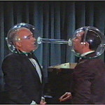
Discussions With Staff
Staff answer questions or provide information to individual Board members so long as any views or positions expressed by the member are not communicated to other members of the Board

Slide 16
What ISN’T a Meeting?
Attendance of majority at
  regional/state/national conference
  local meeting open to the public
  social, recreational, ceremonial event not sponsored by or for the body
are OK PROVIDED no collective discussion of Commission business

Slide 17
New for 2021 – AB 992
Applies to Social Media (e.g., Twitter, Facebook, Instagram, Reddit, etc.)
Meeting does not include “engaging in separate conversations or communications on [Social Media] to answer questions, provide information to the public, or to solicit information from the public regarding a matter that is within the subject matter jurisdiction of the legislative body…”

Slide 18
…still…
No “discuss[ion] among [members about] business of a specific nature that is within the subject matter jurisdiction of the legislative body”
No “responding directly to any communication…regarding a matter that is within the subject matter jurisdiction of the legislative body that is made, posted, or shared by any other member of the legislative body”
  Government Code sec. 54952.2

Slide 19

*Meetings: Locations and Time
Meetings must be held within Alameda County
Meetings must occur at a time and location set by ordinance, resolution, or bylaws
Meetings includes teleconferences

Slide 20
*“Teleconference” =
“a meeting of a legislative body, the members of which are in different locations, connected by electronic means, through either audio or video, or both.”
“Nothing in this section shall prohibit a local agency from providing the public with additional teleconference locations.”

Slide 21
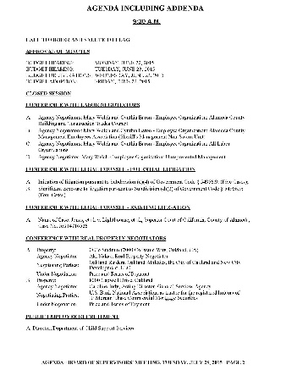
*Teleconference Rules
Each teleconference location must be identified in the notice and agenda
Agenda must be posted at each location
Each location must have public access
Public must have opportunity to speak at each location
A quorum must be inside the County
All votes must be taken by rollcall

Slide 22
*Teleconference cont.
The body must “conduct teleconference meetings in a manner that protects the statutory and constitutional rights of the parties or the public appearing before the legislative body of a local agency”

Slide 23
*Temporary COVID-19 exceptions
Executive Orders:
  N-25-20 (March 12, 2020)
  N-29-20 (March 17, 2020)
  N-35-20 (March 21, 2020)
Suspends:
  Each teleconference location must be identified in the notice and agenda
  Agenda must be posted at each location
  Each location must have public access

Slide 24
*…continued…
Roll call voting;
Allows simultaneous updates about a declared emergency from local, state, or federal officials;
  Can ask questions to the updaters
  For update purpose only, i.e., no official business by the legislative body

Slide 25
*COVID-19 exceptions expiring
on September 30, 2021
  Executive Orders N-08-21 (signed June 11, 2021)
Though further extended through January 31, 2022, under AB 361; Gov. Code sec. 11133 (eff. 9/16/21)

Slide 26
Notice & Agenda Requirements
Regular meeting agendas must be posted 72 hours in advance of the meeting
Special meeting agendas require only 24 hours advance notice
Agendas must describe each item to be considered in enough detail that a person of ordinary intelligence could determine whether the item is of interest

Slide 27


Why Does It Matter?
A body subject to the Brown Act
may not discuss and
may not act on items not on the agenda or that are beyond the reasonable scope of the agenda description

Slide 28

Very Limited Exceptions
Public health/safety emergency
  Immediate need to avoid serious injury to public interest
An item continued from previous agenda and that last meeting was within the last 5 days

Slide 29

These Don’t Need to be On the Agenda
Commendations
Announcements
Request to agendize future items
Limited follow-up to general public comment, to provide information or direction to staff

Slide 30
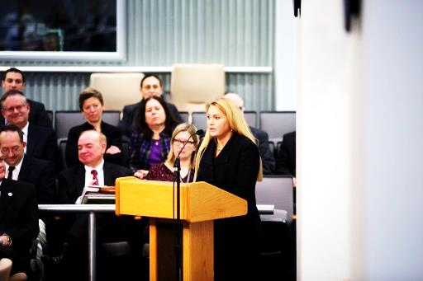
Rights of the Public
ACCESS TO MEETINGS
To have meetings open and public with limited exceptions
To have access to all agendas of public meetings and documents distributed to the Legislative Body members
To audio/video record the meetings and to inspect any recordings of the meetings made by the agency.
To attend without any condition
precedent (e.g., cannot mandate
that attendees register)

Slide 31
Rights of the Public
PARTICIPATION IN MEETINGS
The public has the right to address the Board at any regular or special meeting on any item on the agenda, before conclusion of the discussion or the Board takes action

Slide 32

Types of Public Comment
Specific: Concerning an item on the agenda, at the time of consideration
General: Any item within the Board’s subject-jurisdiction

Slide 33

Specific Public Comment
Any agenda item – discussion or action
Must occur before
  conclusion of consideration of item (discussion item); or
  action taken (action item)

Slide 34
General Public Comment
May occur at any time in the meeting, at the discretion of the Chair/Board majority
Is limited to matters within scope of Board’s jurisdiction, even if not on the agenda
Members may not discuss or respond substantively
Not required at special meetings

Slide 35
Rights of the Speaker
Right to equal time
Right to criticize policy body,
its members, and its staff

Slide 36

Limits on Public Comment
“Up to” three minutes on an item
Reasonable limit on total public comment time on an item
No right to a response from policy body or its members

Slide 37

Controlling Unruly Speakers
Board Chair can impose reasonable time, place, and manner restrictions on public participation
Unruly speakers may be excluded from the forum if necessary to allow business to continue

Slide 38

Closed Session
Meetings must be open to the public unless the Brown Act specifically authorizes the Board to meet in “closed session”
It may not be likely that the Commission will have any closed session matters; any plans to hold a closed session can be discussed with office of the county counsel prior to being placed on an agenda.
Example Topics:
Personnel
Litigation
Labor Negotiations
Real Estate Negotiations

Slide 39
Closed Sessions
Closed sessions are limited to a few specified circumstances and fact specific
Standard is NOT whether the subject matter is sensitive, embarrassing, controversial or ‘private’
Only Board members and necessary support staff can be present in closed session

Slide 40

Criminal Penalties
Willful violation of Brown Act
  Action taken in violation of Brown Act
  Member intends to deprive the public of information to which the public is entitled
Misdemeanor
  punishable by imprisonment in the county jail not exceeding six months, or
  by fine not exceeding one thousand dollars ($1,000), or
  by both

Slide 41

Other Potential Penalties
Invalidation of action taken in violation of Brown Act
Injunction or declaratory relief to stop or prevent violations
Disciplinary action
Prevailing plaintiff may get attorneys’ fees and/or costs
Referral to grand jury for disclosing closed session discussion

Slide 42

QUESTIONS?

