Slide 1
Reimagining Justice in Alameda County
Angela Irvine, Ph.D.
Ceres Policy Research
January 9, 2019

Slide 2
Justice Reform Successes
Youth incarceration has been reduced 41% across the country.
California has seen even more dramatic improvements.
We have gone from 10,000 youth in DJJ to just over 600.
We have gone from 10,000 youth in county facilities to less than 4,000.
See Davis et. al., 2014.

Slide 3
Ongoing Improvements to be Made
At the same time:
Racial and ethnic disparities continue
90% of incarcerated youth in California are Latino/-a, Black, Native American or have multiple racial/ethnic identities.
See Irvine, Wilber, and Canfield, 2017.

Slide 4
Ongoing Improvements to be Made
Up to 80% of youth in the California justice system are charged with non-serious, non-violent crimes.
These are crimes that can, according to California law, be diverted by police prior to formal arrests.
The additional 20% could be parsed and addressed differently from a public health perspective.
See Countywide Criminal Justice Coordinating Council, 2017.

Slide 5
Public Health Perspective on Violent Charged
Recent data analysis of assaults and robberies by Ceres Policy Research shows that among 150 violent crimes, there were
20 cases where there was a serious injury (stabbing, shooting, concussion, hospitalization, or multiple assailants),
22 cases where a firearm was used,
43 cases of grand theft, and
65 cases that DIDN’T involve a serious injury, firearm, or grand theft.
This leaves room to differentiate between the types of harm caused by crime and think creatively about restorative responses.

Slide 6
Alameda Placements
78% reduction in out-of-home placement
846 youth 2010-2013 compared with
140 youth 2014-2016.
Irvine and Soto, 2018.

Slide 7
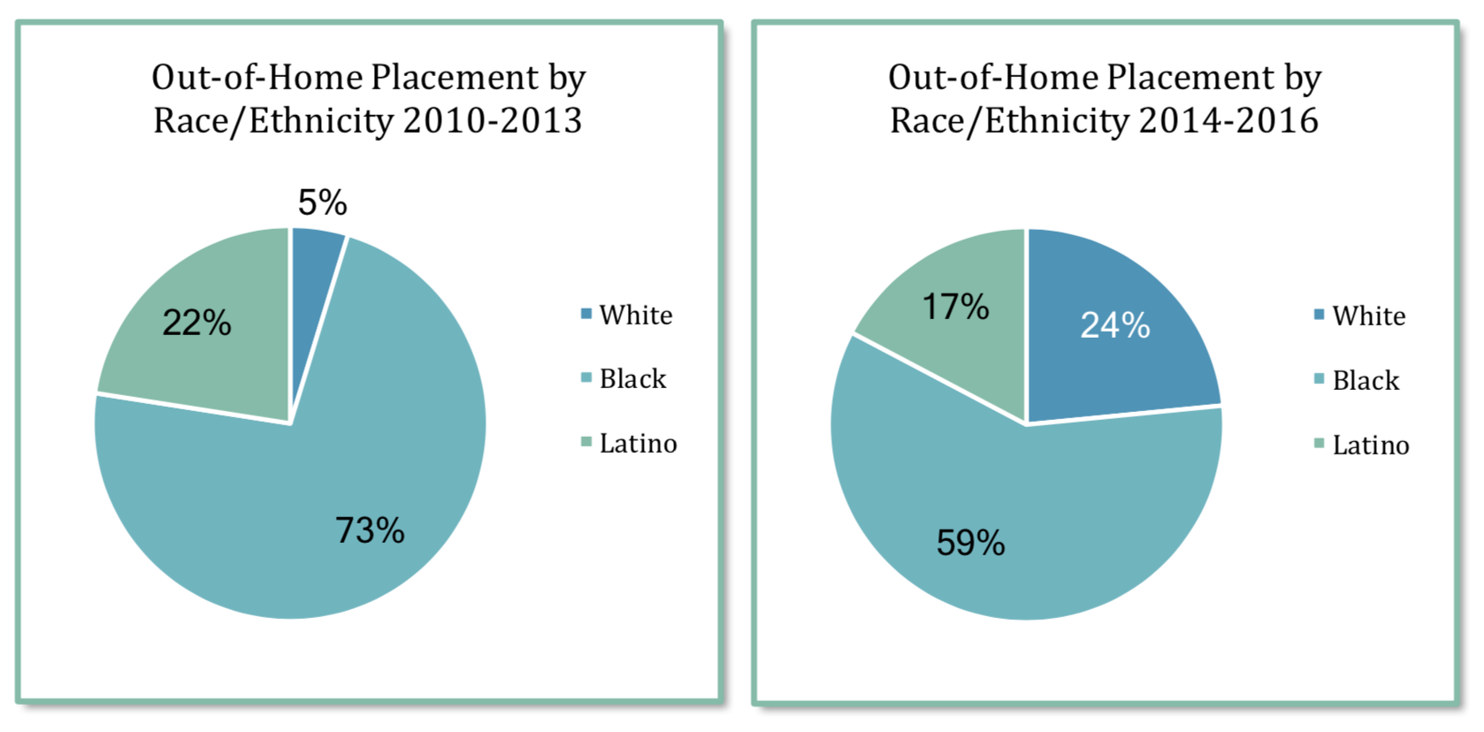
Reduction in Racial/Ethnic Disparities
Irvine and Soto, 2018.

Slide 8
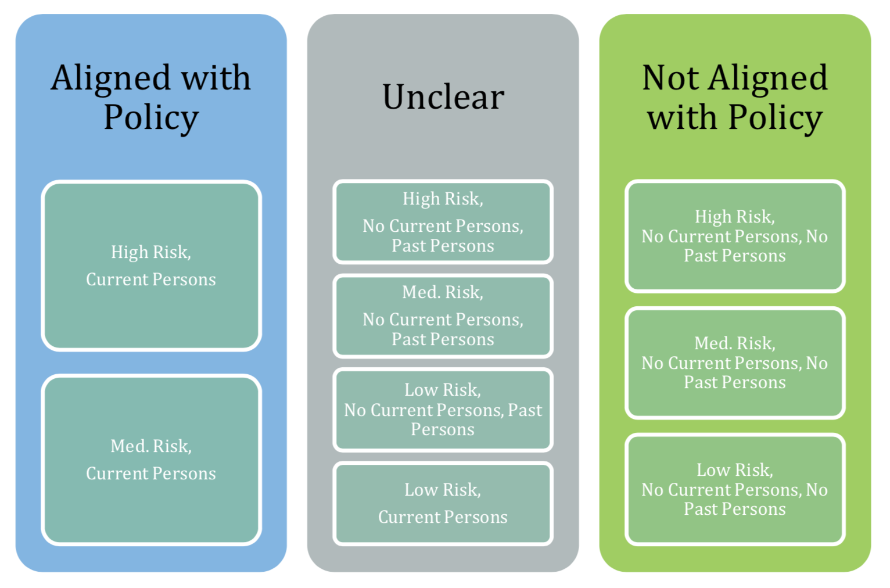
Irvine and Soto, 2018.

Slide 9
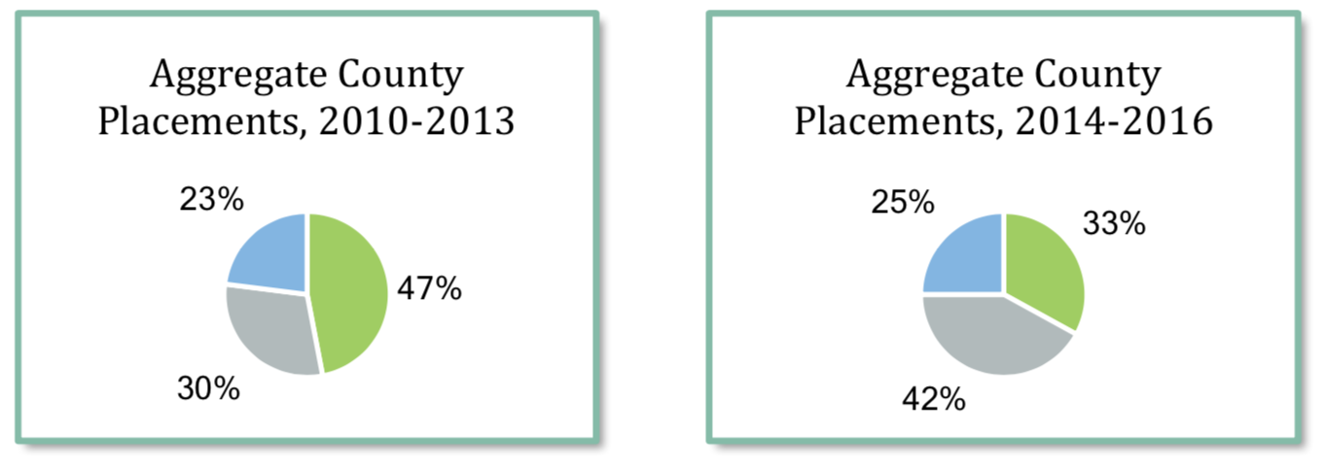
Irvine and Soto, 2018.

Slide 10
Magnitude of Change
2010-2013
402 cases not aligned with policy
256 cases unclear
2014-2016
46 cases not aligned with policy
59 cases unclear
105 cases in three years
35 cases per year
Irvine and Soto, 2018.

Slide 11
Restorative Justice is More Effective—
Particularly with Violent Crimes
baliga (2017) found that recidivism in Alameda County was significantly lower when restorative circles were used as a way to address violent crimes.

Slide 12
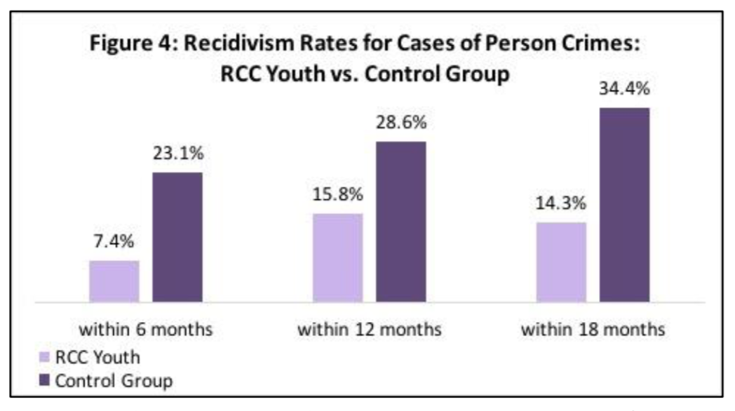

Slide 13
Community-Based Programs
Are Also More Cost Effective
The cost of incarceration is, on average, $240 a day.
The cost of community programs is, on average, $75 per day.
See Fazal, 2014.

Slide 14
Alameda Data
Alameda arrested 1816 youth in 2016.
149 of these young people were charged with status offenses
852 of these youth were charged with misdemeanors
815 of these youth were charged with felonies.
42 of these felonies were drug charges
258 of these felonies were property felonies
350 of these felonies were violent/person charges
See Center for Juvenile and Criminal Justice, 2018.

Slide 15
Alameda Data
Added a different way:
1001 youth were arrested for status offenses and misdemeanors
300 youth were arrested for low to moderate level drug and property felonies
350 youth arrested for violent felonies
See Center for Juvenile and Criminal Justice, 2018.

Slide 16
Alameda Data
34 of the youth charged with a misdemeanor were incarcerated
35 youth per year are placed in out-of-home placement for non-serious and non-violent crimes
See Center for Juvenile and Criminal Justice, 2018 and Irvine and Soto, 2018.

Slide 17
Just Imagine…
The cost of sending 69 low to moderate level youth to ranch or group homes for an average of six months costs $3,000,000 per year.
If we spent the same amount on community programs, we could:
Spend $375,000 for short-term 3-5 day pre-arrest diversion programs for the 1001 youth charged with status offenses and misdemeanors
$202,500 for 3-month weekly diversion programs for 75% (225) of the 300 youth charged with drug and property felonies.
$1,080,000 for six-month intensive community programming that meets twice a week (diversion or post-adjudication) for 75 youth with drug and property felonies and 300 youth with violent felonies.
$936,000 for stipends for youth in intensive community programming that equate to $13/hour for four hours of their time for each day of programming.
Calculated using Fazal’s estimate of 240/day for incarceration versus $75/day for community program.

Slide 18
References
baliga, s., Henry, S., & Valentine, G. (2017). Restorative Community Conferencing: A study of Community Works West's restorative justice youth diversion program in Alameda County. Oakland, CA: Impact Justice and Community Works West.
CCJCC Youth Diversion Subcommittee & The Los Angeles County Chief Executive Office. (2017). A Roadmap for Advancing Youth Diversion in Los Angeles County. Los Angeles, CA: The County of Los Angeles.
CJCJ. (2018). Juvenile Justice Practices in California by County. San Francisco, CA: Center for Juvenile and Criminal Justice.
Davis, A., Irvine, A., & Ziedenberg, J. (2014). Stakeholders' Views on the Movement to Reduce Youth Incarceration. Oakland, CA: National Council on Crime and Delinquency.
Fazal, S. M. (2014). Safely Home: Reducing youth incarceration and achieving positive youth outcomes for high and complex need youth through effective community-based programs. Washington, DC: Youth Advocate Programs Policy and Advocacy Center.
Irvine, A., & Soto, D. (2018). Reducing Out-of-Home Placements in Alameda: Successes, Challenges and Lessons. Oakland, CA: Impact Justice.
Irvine, A., Wilber, S., & Canfield, A. (2017). Lesbian, Gay, Bisexual, Questioning, and Gender Nonconforming Girls and Boys in the California Juvenile Justice System: A Practice Guide. Oakland, CA: Impact Justice and the National Center for Lesbian Rights.

