Slide 1
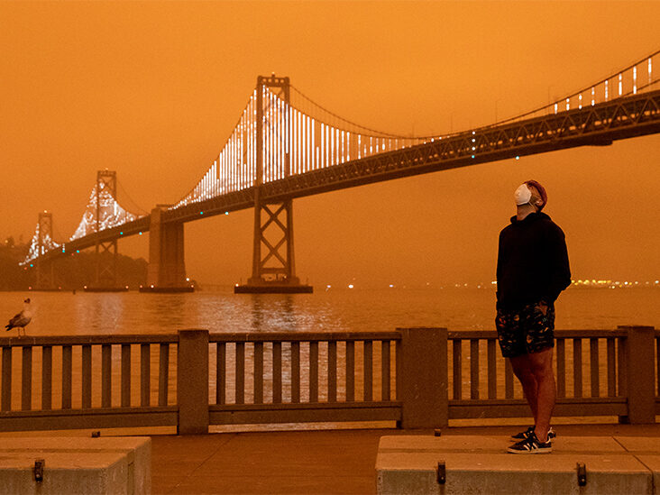
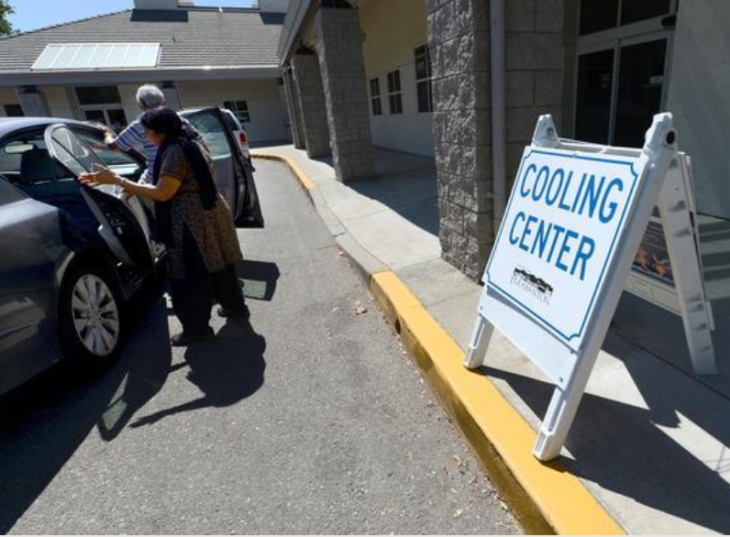
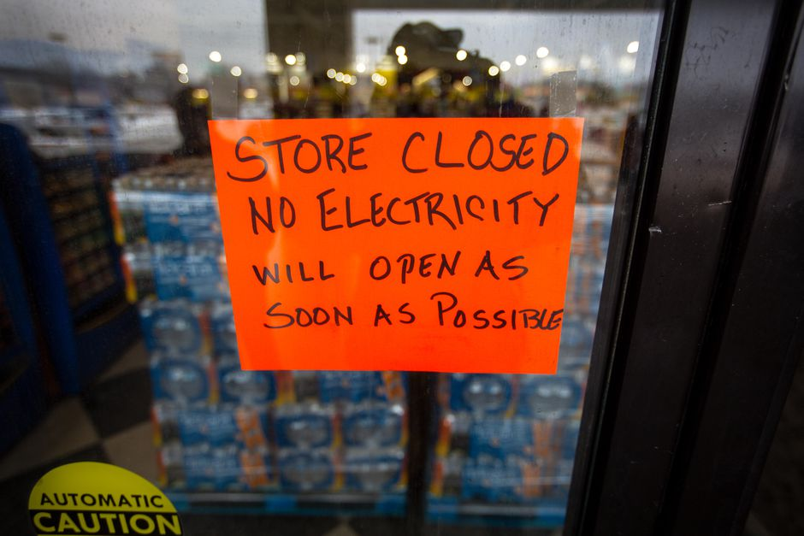
Wildfire & Heat Season Training
Based on materials developed by City of San Leandro Sustainability, Alameda County Office of Sustainability and Alameda County Health Emergency Preparedness and Response
Notes:
Hi, this is {Name and Title, organization you are representing}
We are in the midst of heat and fire season in the Bay Area, so we are glad to provide some guidance today to prepare and respond to related threats.
This workshop is designed in a train-the-trainers model – specifically for organizations or programs who might share this information with others in your community, to prepare for heat waves, wildfire smoke, power shutoffs and more.
This workshop is based on materials developed by City of San Leandro Sustainability, Alameda County Office of Sustainability and Alameda County Health Emergency Preparedness and Response. When sharing or presenting materials, please provide credit, and modify with care.

Slide 2
Overview
Who we are
Climate change and health equity
Guidance for major seasonal risks
Increased heat
Wildfire smoke
Power shutoffs
Resources for you
Notes:
[Provide background information about who is leading the training, the various offices]
Then we will go into highlights about climate change from health equity and why we are looking at these issues
Then we will dive in deep into heat, wildfire smoke, and power outages, and
Share resources you can use.

Slide 3
Purpose
Train on best practices
Provide resources/ guidance from local agencies
Identify frontline populations
Audience: community-based organizations, service providers, and leaders
Outcome: More resilience and adaptability to seasonal threats
Notes:
Today, we aim to…
Train on best practices
Provide resources/ guidance from local agencies
Identify frontline populations
We’re sharing information tailored for community-based organizations, service providers, and leaders who might be able to use it to protect your own teams and organizations, and also share widely with members
Outcome: More resilience and adaptability to seasonal threats

Slide 4
Notes:
{add information about your city or program here, and how participants might access slides or additional information after the presentation}

Slide 5
Key Conclusions
“Frontline communities”: Low-income residents, communities of color, people with disabilities, are disproportionately impacted by climate change. We have seen this locally with heat waves and wildfire impacts.
It is important for individuals to understand the impact of climate change on human health so they can begin planning to protect themselves.
It is important for them to be connected to avenues for information so they can access up-to-date tips during an event.
Notes:
Some populations, such as low income residents, communities of color, people with disabilities: they're all known as “frontline communities” because they tend to be impacted first and worst by things like heat waves, wildfire smoke, and are impacted disproportionately to their ability to respond to these types events.
We now know that the heat waves and wildfires are likely to reoccur seasonally. It is important for both those residents and also community-based organizations or others like yourselves who serve those communities to better understand how climate change is going to be impacting resident's health and also how to plan and protect ourselves.
It’s useful for programs, community-based organizations, and partners in the field to share up-to-date information about best practices and protective actions, and if possible, act as a resource before and during events.

Slide 6
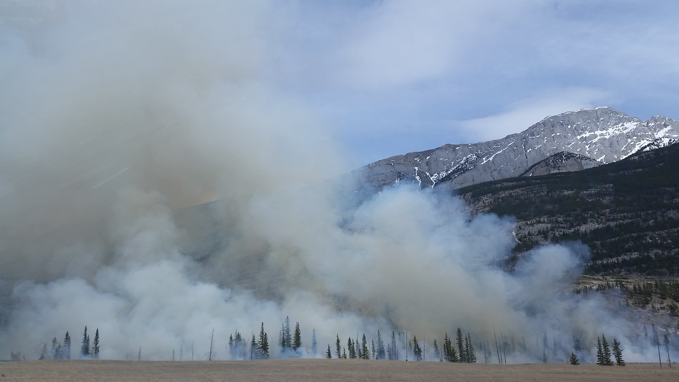
Sept 20, 2021
Jun 20, 2022
Aug 6, 2022
Aug 29, 2021
Notes:
These are some highlights from just 2 months of 2023 & 2022, showing headlines about heat waves, power outages, and wildfire smoke.
It demonstrates that these events are already happening and are going to continue.
These will have real impacts for our community – with infrastructure impacted, businesses closing, impacts to human health, and more.
https://www.usatoday.com/story/news/world/2019/05/13/climate-change-co-2-levels-hit-415-parts-per-million-human-first/1186417001/
https://www.nytimes.com/2019/02/21/climate/green-new-deal-questions-answers.html
https://www.latimes.com/local/california/la-me-california-state-climate-change-assessment-20180827-story.html
https://www.nationalgeographic.com/environment/2018/11/climate-change-US-report0/

Slide 7
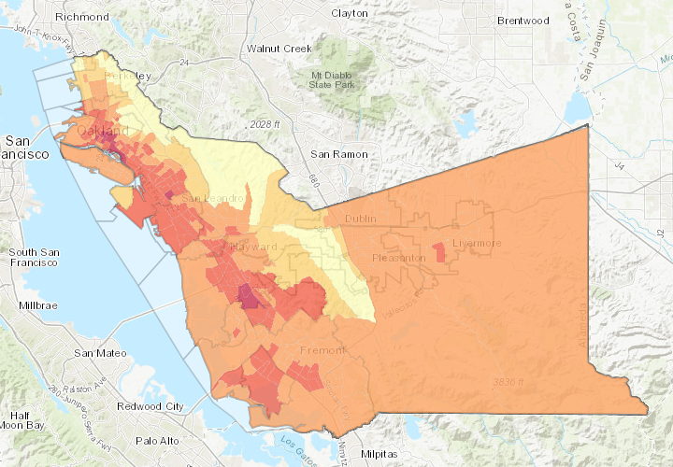
Climate Impacts in Alameda County
Local Hazard Mitigation Plan (link)
Flood Hazards
Sea Level Rise
Wildfire Risk
Heat Vulnerability in Alameda County (map)
Notes:
{substitute city-specific maps or data, if desired}
Alameda County’s geography exposes residents to sea level rise, nearby wildfires, heat and more. Map resources can help your community identify the most relevant risks to you. This slides shows heat vulnerability from a composite map, and the County’s Local Hazard Mitigation Plan features other maps and information.

Slide 8
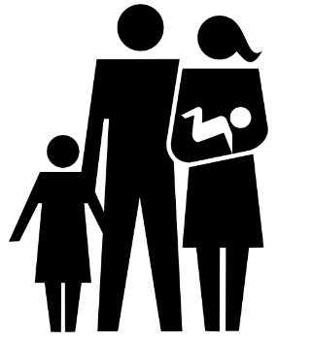
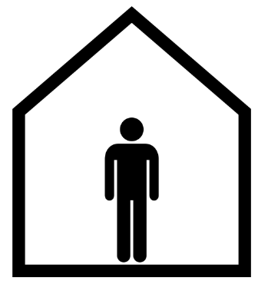
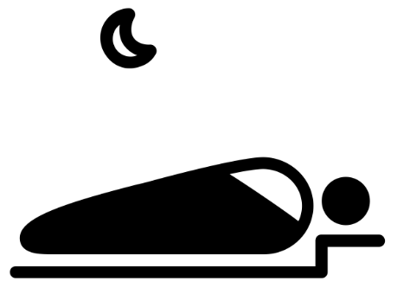
Whose Health Is Affected?
People with Disabilities
Low Income Communities of Color
People Living Alone
People Experiencing Homelessness
Older Adults
Children
Notes:
Who is going to be impacted by these types of events? Frontline communities will be impacted first and worst by climate change. Frontline residents may not have resources to adapt or respond. These include people with disabilities, low income communities of color, people living alone or who are socially isolated, people who are unhoused, elders, children, as well as people who work outside.
You can also have residents facing multiple vulnerabilities at once.
For community based organizations, it may be useful to understand how your constituents will be impacted and how best to support them during these types of events.

Slide 9
https://www.cdph.ca.gov/Programs/OHE/CDPH%20Document%20Library/CHPRs/CHPR001Alameda_County2-23-17.pdf
Notes:
If you want to get into a deeper dive into the connections of climate change and health, this is a useful report from the state public health department that gives a profile for the impacts of climate change and health. This is specific for Alameda County. The link is on the slide.
https://www.cdph.ca.gov/Programs/OHE/CDPH%20Document%20Library/CHPRs/CHPR001Alameda_County2-23-17.pdf

Slide 10
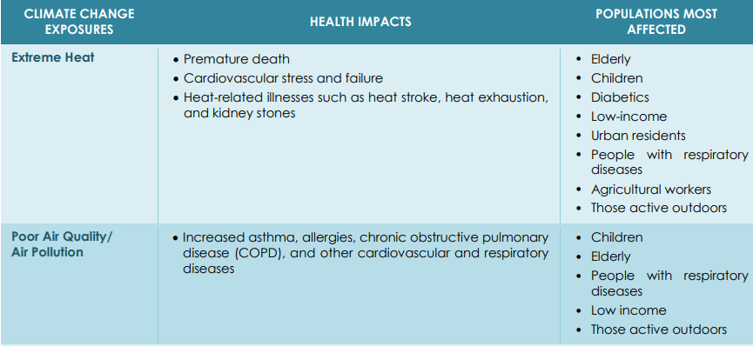
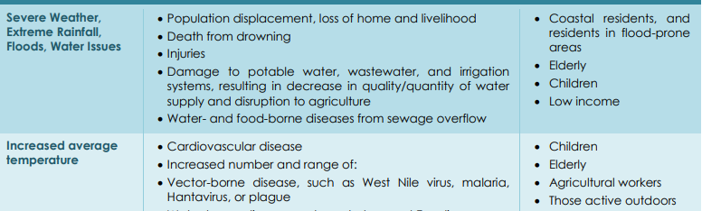
Notes:
The report shares helpful data. In this table, each of the different climate impacts appears on a row, with health impacts and who will be most affected.
The populations that tend to be impacted are the ones we just looked at, the frontline communities, who don't necessarily have resources to be responding to these events.

Slide 11
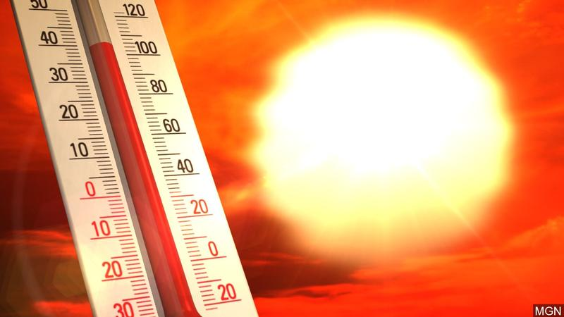
Heat and Its Impacts
Notes:
For the rest of the presentation, we will cover specific threats, including what is expected, resources available, and best practices and protective actions. First, we will address heat.

Slide 12
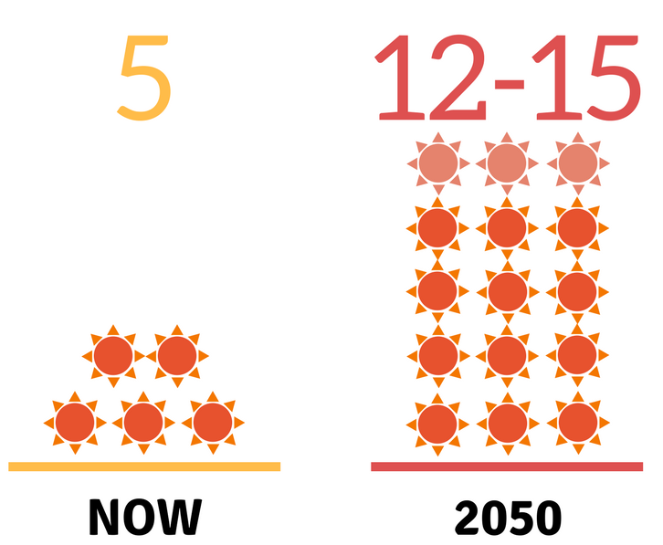
Climate Impact: Extreme Heat
16
Projected Average Number of Extreme Heat Days
Annually in Alameda County
Reference: CalAdapt
Notes:
CalAdapt, which is a database for climate data, shows that regionally across Alameda County we are expecting about 5 extreme heat days annually now. This is expected to go up to about 16 days by mid century.
Even though right now you can have relief during the night as we get further into high temperatures and so on the nights are getting hotter as well so you don't get relief from high temperatures at night.
[As a reference, in parts of our County, extreme heat days are defined as days where the temperature is above 92.6 degrees.]

Slide 13
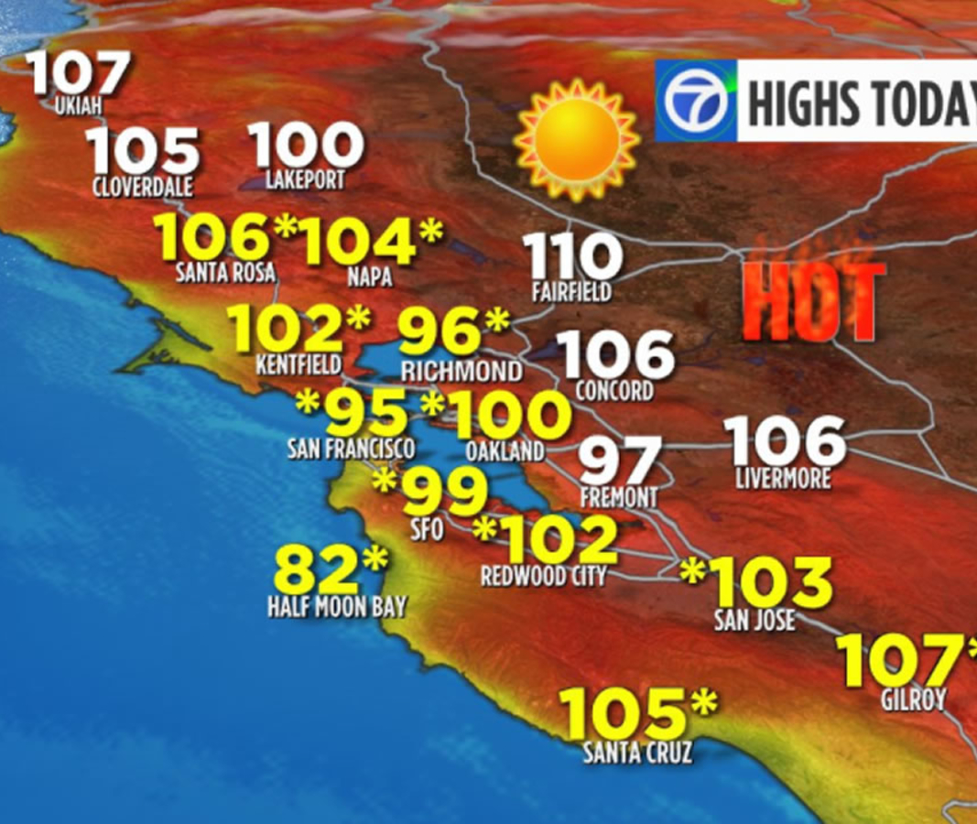
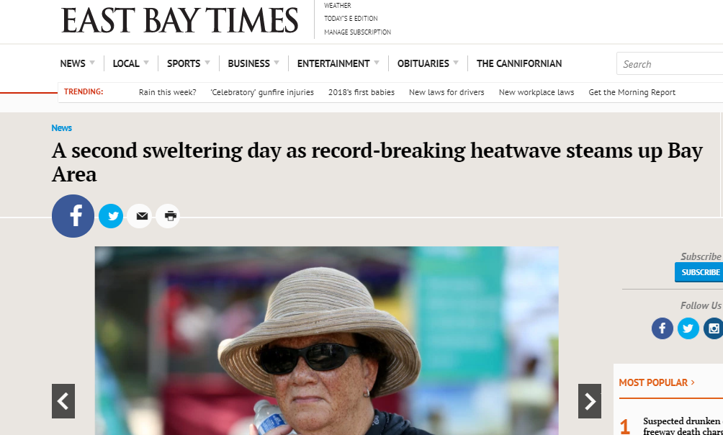
The Impacts Can Already Be Felt
Notes:
The impacts of heat waves are already being felt.
These are some of the headlines from a heat wave a few years ago. We had temperatures over 100 degrees, and had a couple of people pass away for related illnesses in nearby counties.
It's important to note that death from heat related illnesses is preventable but symptoms aren't typically as widely known.
Helping spread the word about the signs of heat stress can help our communities respond.
Heat related illness, especially for populations that are frail or medically sensitive, can really spike in high temperatures.
We don’t know the details, but we know none of those six who died called 911 for help. [In total, 14 people died from extreme heat in the Bay Area that year, more than for any other disaster. (Source for deaths info: https://abc7news.com/weather/record-setting-heat-wave-to-blame-for-6-bay-area-deaths/2388144/) (https://www.kqed.org/science/1932903/extreme-heat-killed-14-people-in-the-bay-area-last-year-10-takeaways-from-our-investigation)
Note—these are all articles published between Aug. 30-Sept. 8, 2017

Slide 14
Vulnerability Factors
People with pre-existing health conditions or medications that increases sensitivity to heat
Low-income people who are unable to adapt (e.g. cannot buy more food if power outage shuts off refrigerator)
Elders
The unhoused
People living in homes without air conditioning or do not run air conditioning because of cost
Outdoor workers (ie construction, landscaping, public works, agricultural)
People who are socially isolated without others checking in on them
Intersecting vulnerabilities increase risk
Reference: CDPH
Notes:
There's a number of different vulnerability factors that folks need to be paying attention to related to heat.
People with pre-existing health conditions may make them more sensitive to heat.
Elders will also be more sensitive because of older adults tend to sweat less which is one of the ways that the body keeps cool.
People who are unhoused obviously are exposed to heat from being outside.
Folks who live in homes without air conditioning are susceptible.
Folks who don't run air conditioning because of the cost could also be at risk.
People who work outside in construction, landscaping, public works, and agricultural workers also are vulnerable.
People who are socially isolated isolation have a significant risk factor of dying from heat stroke because we know heat can cause confusion and lost consciousness - if you don't have people regularly checking in on people who are living alone, that can pose a risk.
Any type of intersecting vulnerabilities across these different areas will cause increased risk.
Some of the factors that increase sensitivity to heat are common in older adults.
Preexisting conditions
Older adults generally sweat less, which is one of the body’s main ways to keep cool, and have trouble keeping hydrated.
Heat can also exacerbate existing illnesses and reduced mobility can make it harder to evacuate or seek help.
Older adults may not have access to air conditioning or may not want to run their air conditioning due to high costs.
In addition, isolation is a huge risk factor in dying from heat stroke since heat illness can create confusion and loss of consciousness
https://www.cdph.ca.gov/Programs/EPO/Pages/BI_Natural-Disasters_Extreme-Heat_Seniors-and-Heat-Illness.aspx
https://www.cdph.ca.gov/Programs/EPO/Pages/BI_Natural-Disasters_Extreme-Heat_Tips-for-Preventing-Heat-Related-Illness.aspx
Image source: EPA: Climate Change and the Health of Older Adults

Slide 15
Cooling Centers
Centers that comply with COVID protocols will go live on this platform below. Data will change as conditions change.
Best cooling centers are places people already know as they are more likely to visit them. Any safe, air conditioned space can benefit a community during a heatwave.
https://veoci.com/v/p/dashboard/ewxv8granu
Notes:
One of the resources that is available for people in a heat event is cooling centers.
These are public places where people can go to access air conditioning during building operational hours.
You can find the list of those sites at this link.
Data may be changing as conditions change, so its best to keep up with openings at this link.
The best cooling centers are places that people already know and already have a relationship because they are more likely to visit them.

Slide 16
Notes:
Trees can also provide protection from heat.
Trees can cool down streets by 2 to 4 degrees which will reduce the urban heat island effect and also help to save energy costs.
They also have variety of other benefits including reducing air pollution, providing habitats for birds and pollinators, not to mention stormwater health benefits, increasing property value, providing green space. They are a very important resource for the community.

Slide 17
Preventing Heat Illnesses
Check on neighbors and community members, esp. those living alone
Stay hydrated
Stay in air conditioning as much as possible (esp. when temp.’s high 90s or above)
Wear loose, lightweight, light-colored clothing
Shower/bathe in cool water
Cool cloths on neck, hands, and feet
Avoid strenuous activities
Reference: ACDPH
Notes:
This slide covers some information on preventing heat illness as well as recognizing signs of heat illness.
Let's start with the image on the right developed with information from the public health department and describe some of the symptoms for heat exhaustion and heat stroke.
Some of the things that you want to keep an eye out for include: having headaches, dizziness, heavy sweating, damp skin, nausea, and weak pulse, muscle cramps, loss of consciousness.
Heat exhaustion can look similar to heat stroke. Both are serious, and heat stroke is potentially life-threatening.
Someone with heat stroke may not sweat, and may show confusion.
This image is available as part of the larger flyer around heat and health and we'll have the links to those resource guides which are in multiple languages for your members.
During, before, and after in terms of preventing heat illness, best practices they're recommending include: checking in on neighbors, particularly those who are socially isolated, staying hydrated with cool water, staying in air conditioning as much as possible, wearing loose lightweight light colored clothing, showering and bathing in cool water, and putting cool cloths on your neck, your hands, and your feet, and avoiding strenuous activities.
Lots of things that older adults and those who care about them can do
Check in on each other
Staying hydrated and in cool conditions
Low cost ways
https://www.cdph.ca.gov/Programs/EPO/Pages/BI_Natural-Disasters_Extreme-Heat_Seniors-and-Heat-Illness.aspx
Let’s turn to what individuals can do to prevent heat illness, according to the California Department of Public Health
Check on a friend or neighbor and have someone do the same for you.
Stay hydrated. Don't wait until you're thirsty: drink plenty of cool water, juice or sports drinks.
Stay in air-conditioned buildings as much as possible. If your home doesn't have air conditioning, go to a cooling center.
Electric fans may provide comfort, but when the temperature is in the high 90s, fans will not prevent heat-related illness.
Wear loose, lightweight, light-colored clothing.
Shower or bathe in cool water frequently. (cold towel)
Do not engage in very strenuous activities and get plenty of rest.
https://www.cdph.ca.gov/Programs/EPO/Pages/BI_Natural-Disasters_Extreme-Heat_Seniors-and-Heat-Illness.aspx

Slide 18
Wildfires/ Smoke
Notes:
Now we will address wildfire smoke – causes, impacts, and protection from this threat.

Slide 19
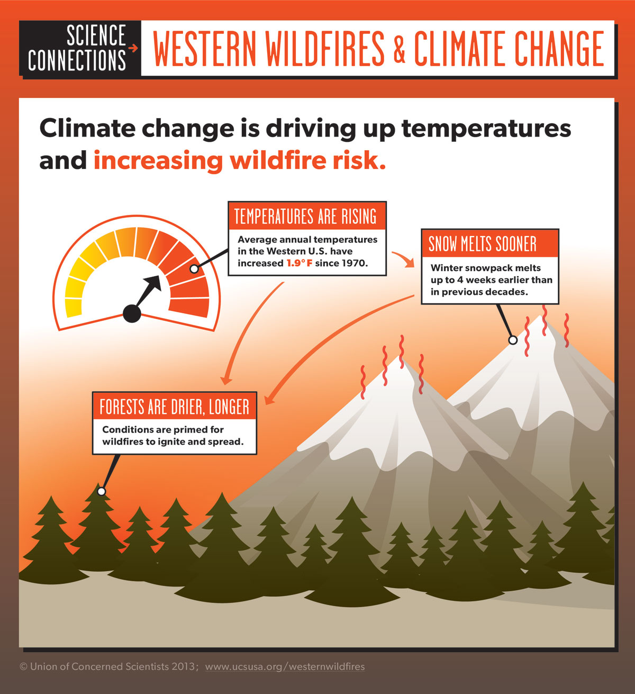
Climate Impact: More Frequent and Severe Wildfires
TEMPERATURES
ARE
RISING
SNOW
MELTS
SOONER
FORESTS ARE
DRIER, LONGER
Notes:
With climate change, we have higher temperatures as well as snow melt happening sooner.
Both of these conditions combined result in a drier longer season and forest which lead to more frequent and severe wildfires.
Image Credit: Union of Concerned Scientists. https://www.ucsusa.org/global-warming/science-and-impacts/impacts/infographic-wildfires-climate-change.html#.WqGJ2OjwaM8

Slide 20
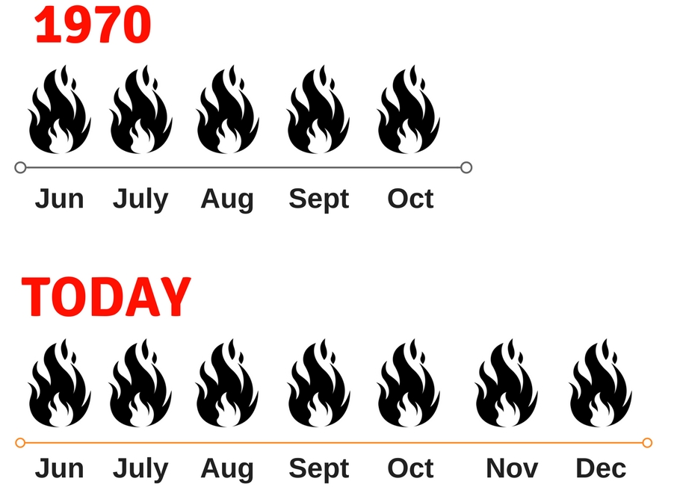
Longer Wildfire Season
Notes:
Also due to dry conditions, what used to be a 5 month fire season in 1970s or so is now 7 months of fire season. This is now our new normal. We're seeing this happen year after year and that is resulting in smoke events for the Bay Area.
Image Credit: Union of Concerned Scientists. https://www.ucsusa.org/global-warming/science-and-impacts/impacts/infographic-wildfires-climate-change.html#.WqGJ2OjwaM8

Slide 21
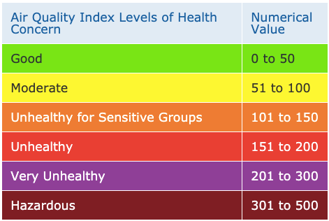
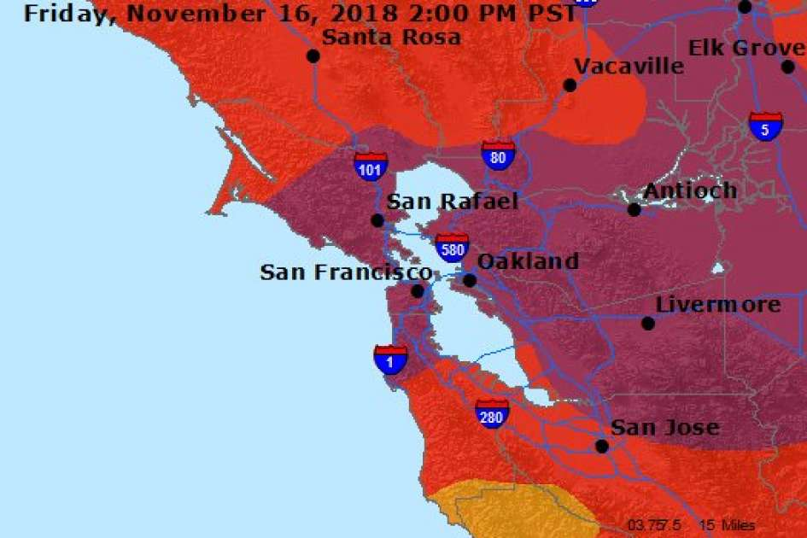
Air Quality Readings
Notes:
This slide shows a map from the Air District for November 2018 during the raging fires we experienced.
As you can see, “purple” means Very Unhealthy air quality. This level hadn’t been seen before the 2017 fires in the Bay Area, but here we see the county blanketed with purple. Readings were unhealthy for several days.
How can we see how bad the air is? There are a couple of things to pay attention to during smoke events.
This Air Quality Index is used widely, including in maps, and it’s good to be familiar with it. The numbers correspond to the particulates in the air, and this is scaled to what is healthy or not healthy for particular groups.

Slide 22
Vulnerability Factors
People with diabetes, heart or lung disease, such as heart failure, angina, ischemic heart disease, chronic obstructive pulmonary disease, emphysema or asthma.
Older adults: elderly more likely to have heart or lung disease than younger people.
Caring for children, including teenagers: their respiratory systems are still developing, they breathe more air (and air pollution) per pound of body weight than adults, they’re more likely to be active outdoors, and they’re more likely to have asthma.
Pregnant women: there could be potential health effects for both you and the developing fetus.
People living in old homes: older homes have more leakage of outdoor air than newer homes or weatherized homes
People working/living outside: construction workers, landscapers, the unhoused, agricultural workers, public works city staff
Reference: CDPH
Notes:
People with diabetes, heart or lung disease are particularly at risk in wildfire smoke. Elders may be, as they’re more likely to have these conditions.
Those who care for young children or teenagers should also be aware because young people have respiratory systems that are still developing so they breathe in more air by body weight the more likely to be outside and they're also more likely to have asthma.
For people who are pregnant, there could be potential health effects for them or their fetus.
People who are living in older homes are more likely to have leakage of outside air.
For people living or working outside, such as construction workers, landscapers or the unhoused, they are also more exposed to these events.

Slide 23
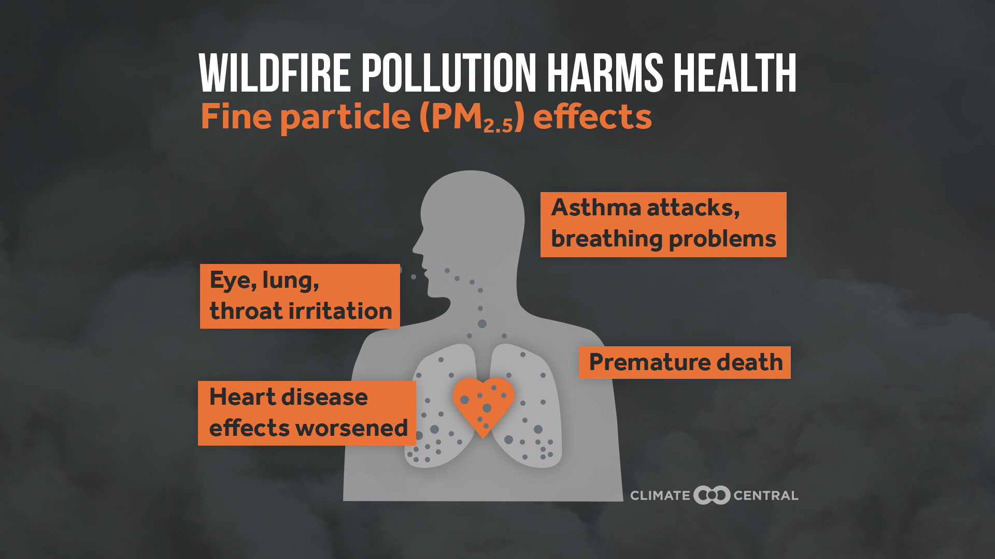
Health Impacts from Smoke
Irritates eyes and airways
Worsens common respiratory conditions, such as asthma and COPD
Can increase risk of heart attack, worsen cardiac issues
Higher risk of long-term effects, esp for children
Can be long-term health impacts even without sudden symptoms like coughing
Reference: Climate Central, ACDPH
Notes:
There are a number of possible health impacts from smoke, mostly because of the fine particular matter that is a main component of smoke.
Smoke not only irritates the eyes and airways, but also tends to worsen respiratory conditions like asthma or other kinds of breathing problems.
You can have increased risk of heart attack or other kind of cardiac issues.
There is also increased risk of long term effects, particularly for young people whose respiratory systems are still developing.
And there can be long-term effects even if there aren’t sudden symptoms.
Sources; EPA report on older adults and climate change
CDPH report: Climate Change and Health Profile
https://www.ucsf.edu/news/2017/10/408766/long-term-health-impacts-wildfire-smoke-may-include-cardiac-respiratory-effects
COPD = chronic obstructive pulmonary disease

Slide 24
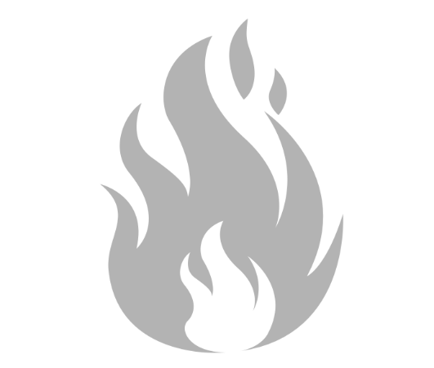
Smoke Communication
Not all community members get text alerts from Alameda County or city government due to tech barriers or language barriers
Community-based organizations serve as an important bridge and information provider for communities.
Signing up for Alameda County Alerts (AC Alerts) and following County social media will keep you informed
www.ACAlert.org
Notes:
Frontline communities may not necessarily be getting the necessary information for these different types of events if they don't have smartphones or computers to access these alerts, or there could be barriers of language or trust of government agencies. Community-based organizations that are trusted by the community can serve as an important bridge.
If your organization signs up for the County’s AC Alert system, or for alerts from your city, or relevant social media accounts, you will receive alerts and can pass information to others.
Visit www.ACAlert.org

Slide 25
Recommended Actions
Stay indoors
Stay hydrated
Keep cool (see Heat Pocket Guide)
Watch for signs of heat illness
Keep indoor air clean
Consider HEPA air purifier
Avoid burning candles, vacuuming, using the stove, fireplaces, tobacco
Limit physical activity outdoors
Wear fitted N95, P100, KN95 masks
Reference: ACDPH
Notes:
There is a suite of outreach materials you can send out with recommended actions. You’ll see these recommendations and this table in the materials.
The Air Quality Index, again, assigns colors to the values in the scale.
At Green and Yellow, it’s OK for most people to be out, unless you are particularly sensitive to air pollution.
Orange is Unhealthy for Sensitive Groups, who are advised to limit time outdoors.
At Red and Purple levels, everyone is advised to limit or avoid activities and exposure outside. This is for any value over 150 in the air quality index.
Generally speaking, the recommended actions are to stay indoors, stay hydrated, and keep cool. Keep your indoor air clean, and limit exercise outdoors.
If you want to wear a mask, you’ll need a fitted N95 type mask – some masks that protect from COVID will not protect against smoke.
https://covid-19.acgov.org/covid19-assets/docs/health-safety/wildfire-smoke-faq-2020.08.28.pdf

Slide 26
Smoke, Heat, and COVID
The ventilation for smoke and COVID are different
Outside air is often brought in to prevent COVID spread
Outside air is harmful in smoke conditions
How can I filter air in my home?
Even without filtered air, staying indoors is the best way to reduce smoke exposure. To filter air, consider a portable HEPA air purifier (make sure it does not produce ozone) or a MERV 13 or greater filter for your HVAC system.
What should you do if all hit at once?
Stay indoors with doors and windows closed
Stay hydrated
Keep cool. Place cool towels over hands, face, feet. Watch for signs of heat illness.
Limit physical activity outdoors, like running, biking, physical labor, and sports.
Keep indoor air clean.
Visit Cleaner Air Center
Create emergency plan with neighbors or household.
Alameda County Smoke and COVID FAQ
Notes:
Something to keep in mind is that the ventilation for smoke and COVID are different. On a smoky day, outside air is harmful. Staying indoors can protect against smoke.
If you want to filter your indoor air, consider a HEPA air purifier or a MERV 13 filter for HVAC air conditioning.
Generally, in these conditions it is recommended to stay indoors and hydrated, have cool towels on your hands and your feet, limit outdoor activities, and stay in touch with your neighbors and your household.
https://covid-19.acgov.org/covid19-assets/docs/health-safety/wildfire-smoke-faq-2020.08.28.pdf

Slide 27
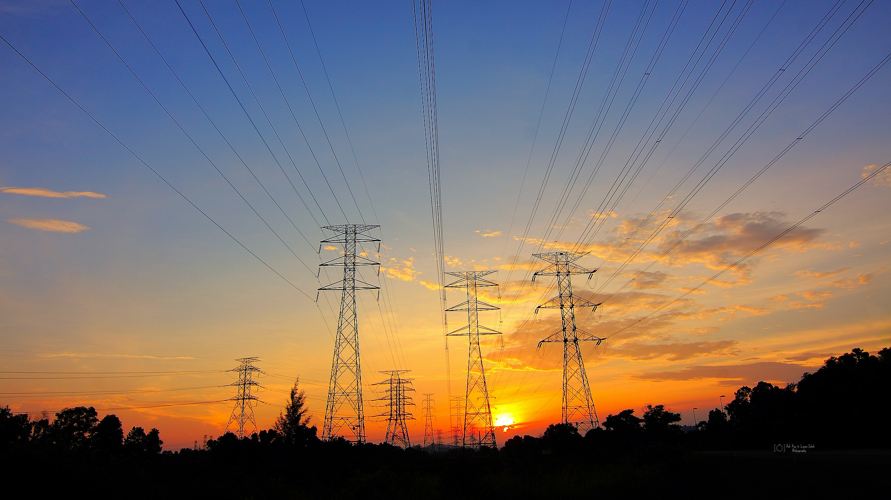
Power Shutoffs
Notes:
Power Shutoffs are another impact that are increasing in frequency. Of course, the power may go out in storm conditions, but there may also be planned power shutoffs designed to limit the risk of wildfires.

Slide 28
PG&E Public Safety Power Shutoffs (PSPS)
Expanded in 2019 to include Transmission Lines that pass through high-fire-threat areas
CPUC’s designated Tiers
Tier 2 – elevated fire risk
Tier 3 – extreme fire risk
CPUC Fire-Threat Map GIS Web Viewer
Notes:
Beginning in 2019, PG&E started turning off power to certain high-fire-threat areas to try to prevent fires from starting.
These are called “Public Safety Power Shutoffs,” or PSPS.
This High Fire Threat District Map is sponsored by the California Public Utilities Commission (CPUC) and is designed specifically for identifying areas where there is an increased risk for utility associated wildfires.

Slide 29
Public Safety Power Shutoff Criteria
Alameda County Fire-Threat Map (6/15/23)
Notes:
There are certain conditions that trigger Public Safety Power Shutoffs.
A Red Flag fire risk warning, low humidity, high winds, dry fuels and local observations all can contribute.
This is a fire threat map for Alameda County captured mid June 2023. There are several areas around the county (oakland & east bay hills) where we can expect high fire risk zones and these areas need to be included in planning for PSPS events.
You can see that there is an abundance of Extreme (Tier 3) Areas in Red along the east bay hills that are surrounded by Elevated (Tier 2) Areas in orange.
If there is a PSPS event, PG&E will provide a map of the impacted areas and customers.

Slide 30
Public Safety Power Shutoff Comparison 2019 – 2021
Notes:
This PSPS comparison chart from 2019-2021 shows that PSPS impacts have declined with improvements to electric system infrastructure. PSPS are still of concern, however, especially for those in high fire-risk areas or in impacted areas from PSPS.

Slide 31
PG&E Public Safety Power Shutoffs Additional Safety Measures
Enhanced Powerline Safety Settings
Advanced safety settings that allow powerlines to automatically turn off power within one-tenth of a second when there is a hazard, like a branch falling into a powerline.
Undergrounding 10,000 miles of powerlines for improved safety and reliability.
Exceeding state vegetation standards to prevent trees and branches from falling onto powerlines.
Installing stronger poles and powerlines to make electric grid safer and more resilient.
Reducing the impact of PSPS with grid updates and weather forecasting improvements to allow more precisely target shutoffs.
Notes:
PG&E is now using Enhanced Powerline Safety Settings, which are
Set in places that are in high fire-risk areas and some adjacent regions.
Additional safety measures are in place as well.
Source: https://www.pge.com/en_US/residential/outages/enhanced-powerline-safety-settings/enhanced-powerline-safety-settings.page

Slide 32
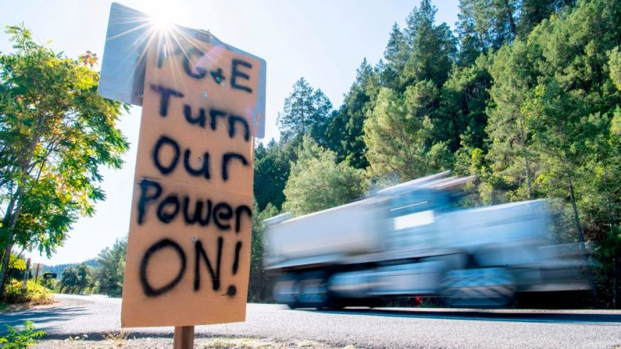
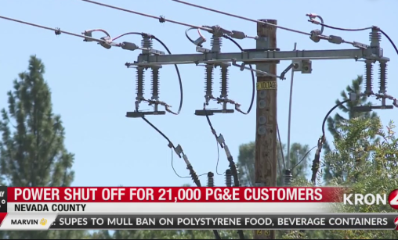
Impacts from Power Shutoffs
Potential impacts
Power outage in residential and commercial neighborhoods
Changes to routines in managing daycare/eldercare
Lights and communication methods like cell phones may lose power
Risk for food spoilage
Risks for medical and mobility devices/equipment
Notes:
When there is a power outage, there can be several impacts. Residential and commercial neighborhoods can be impacted. If you have children or elders in care, this may change your routine if those organizations must close. Lighting and communication methods such as cell phones may lose power.
There’s a risk for a food spoilage because power outages could last for 24 to 72 hours or longer.
There may be risks for people who depend on electric medical and mobility devices.

Slide 33
Vulnerability Factors
People depending on electric medical or mobility devices
Wheelchair users living in multi story apartment buildings
People with refrigerated medication needs (ie insulin)
Food spoilage for low-income people who cannot afford to replace groceries
Caretakers of children or elderly where schools or other facilities are closed
Low-income workers who lose wages due to businesses being closed
Notes:
Vulnerability factors for power shutoffs include:
(read slide)

Slide 34
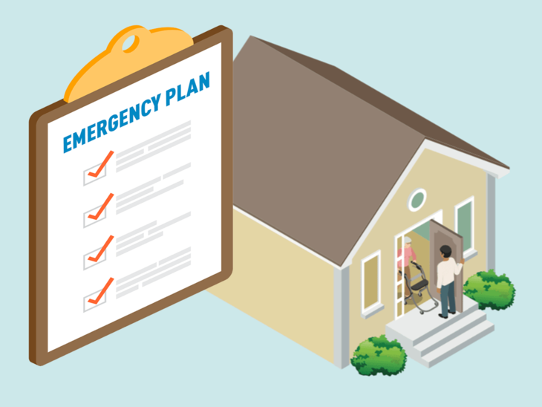
Existing Program Support for Households
Medical Baseline Program
Extra PG&E notifications in advance of PSPS events
PG&E Portable Battery Program for income qualified participants
Vulnerable Customer Status
Customers who have a serious illness or condition that could become life-threatening if their service is disconnected may self-certify as vulnerable customers and receive extra notification in advanced of a PSPS.
Disability Disaster Access & Resources Program
Portable backup batteries, hotel accommodations, accessible transportation, food vouchers
Community Resources for Independent Living (CRIL) in Hayward, CA – 510-881-5743
PSPS portal for planning and event-specific information for public safety government partners
Reference: PG&E
Notes:
The main program from PG&E is the Medical Baseline program. It is for any person with an eligible medical condition or a medical device that uses power. There is no income requirement or threshold, but you do need documentation from a doctor. Once you enroll in the program, this allows you to get a bill reduction for the use of electricity for life saving devices, as well as extra PG&E notifications – they will call you or even come to your door to make sure that you know about planned shutoffs.
The medical baseline program only tells you that the event is happening but it's up to you to prepare.
If you are income qualified in the medical baseline program then you're eligible for their Portable Battery program which allows you to get a fully subsidized battery for use during these events.
There is a Disability Disaster Access & Resources Program that is run by the Centers for Independent Living, serving people with disabilities. They have a suite of support that includes portable backup batteries, hotel accommodation, and food vouchers.
There is also a PG&E Portal for tracking information, designed for government partners well as hospitals.

Slide 35
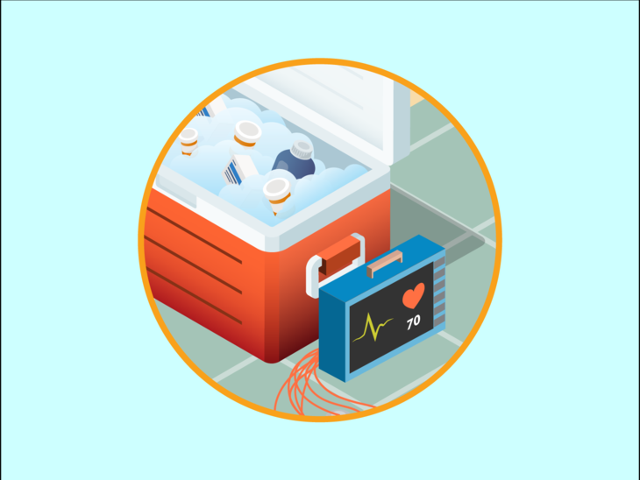
Existing PG&E Program Support
Portable Battery Program
Medical Baseline customers who live in High Fire-Threat Districts and who are reliant on electric-dependent medical devices.
Food Resource Partnerships
PGE is partnering with food banks and meals on wheels to provide family with groceries during a PSPS event and for three days following.
Generator and Battery Rebate Program
Offering eligible customers, a rebate on the purchase of a qualifying generator or battery to prepare for outages
PSPS Preparedness Toolkit
Available in 13 languages, both hard copy and electronic
Safety Action Center
Information to help prepare your home, family, or business for a potential PSPS
Reference: PG&E
Notes:
In addition to the Medical Baseline program, PG&E partners with food banks to provide food replacement packages during PSPS. They have the battery program and a set of outreach materials in 13 languages, in electronic and hardcopy.

Slide 36
Gaps in Support
Support for people not on medical baseline, but require refrigerated medication (i.e. insulin) or other equipment
Medical baseline has a high access barrier with documentation and may be difficult to get on for people with low English skills even if they qualify
PSPS Portal info currently only available to local government agencies, not community health providers
Notes:
There are some populations to be aware of that may not be served by current program offerings. For example, people with refrigerated medication will be affected, but are not served by the Medical Baseline program.
Medical Baseline requires documentation by a doctor, which may take several steps to obtain, and require language skills.
The portal is also only available to government agencies, not community health providers.

Slide 37
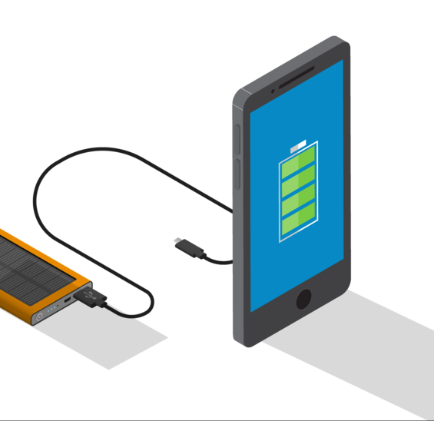
Best Practices for Individuals
Fill medications early
Stock up on durable food
Make your own ice to cool food and limit opening fridge once power is off
Find “buddies” for those living alone
Call 2-1-1 or the Non-Emergency Power Shutoffs Hotline at 833-284-3473 for help
Have backup key for electronic keys and locks
During shutoff, unplug large electrical appliances that may surge when power returns
Keep flashlights and solar/battery lanterns on hand
Reference: PG&E
Notes:
There are several best practices for residents to keep in mind. (read slide)

Slide 38
Community Pod Mapping
Community
Org
Neighborhood
Group
LA family
Encourage your members /clients to do pod mapping to identify who they can contact in these climate events if they need help
Helpful to have out-of-town contacts as well
Write out emergency contact numbers
County emergency pocket guide includes Family Emergency Plan section
Friend
Me
Friend
Parent
Group
Church
Reference: Bay Area Transformative Justice Collective
Notes:
This visual is borrowed from the Bay Area Transformative Justice Collective, and shows a way to think about how residents can stay connected to one another. Social ties can be a beneficial support to everyday wellness, in addition to during disasters or health events.
You can see the resident in the middle, “me,” surrounded by closest contacts, and with networks or support organizations around.
Your clients or members can map their “pods” to see who they might contact during extreme weather. Encourage them to map these, including contacts outside the area, and write out emergency numbers (in case a phone loses power). Alameda County has a pocket guide for emergencies, which includes a section to write out a Family Emergency Plan.

Slide 39
Heat Wave Resources
County emergency management text alert sign up
Alameda
Contra Costa
Alameda County Public Health on Heat and Health (multilingual)
Notes:
The next couple of slides include lists of links that may be useful to you.
We encourage you to sign up for the best alert system for you, in your county and your city if applicable.
You can see here multilingual resources to help you and your communities prepare for heat.

Slide 40
Wildfire Smoke Resources
AirNow fire and smoke map
County emergency management text alert sign up
Alameda
Contra Costa
Alameda County Wildfire Smoke, COVID, and Health FAQ (multilingual)
CDPH Wildfire Smoke FAQ
EPA guidance on clean air during wildfire
Notes:
…and here are links to resources for air quality information, and how to stay protected from smoke.

Slide 41
PSPS Resources
PG&E real-time PSPS Updates
PSPS alert sign up from PG&E
PG&E Prepare for PSPS
PSPS FAQs
PG&E Medical Baseline Program
PG&E Vulnerable Customer Program
Disability Disaster Access & Resources program
PG&E PSPS support resources, including translated outreach material
PG&E Community Resource Centers
California Health and Human Services PSPS Resource Guide
California Public Utilities Commission Fire-Threat Map
Notes:
PG&E provides several resources for planned power shutoffs – see those at these links.

Slide 42
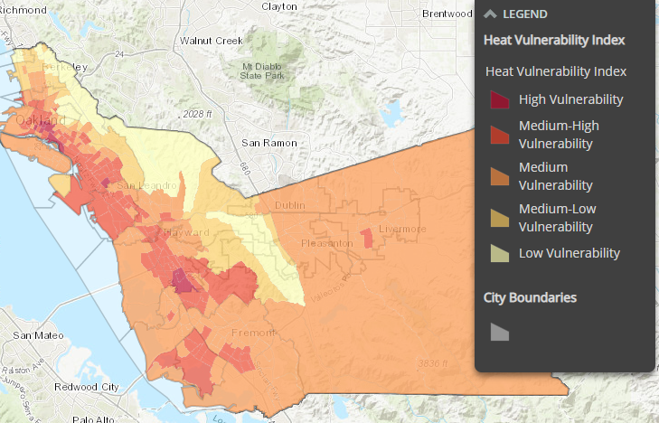
How Can Local Agencies Support You?
What do you need to serve community members before and during climate events?
How do you want to receive info? What is the chain of information?
How to promote neighbor check-ins?
Image: Heat vulnerability map
Notes:
Now, we’d like to open a conversation – how can local agencies support you?
Raise your hand if you have a response – we want to hear what you need to support those in your community, how you can receive information, and how can we encourage these protective actions in the community.
(discuss)
Thank you, we will learn from what you shared today

Slide 43
Breakout Room Discussion
What is that next first step that you could do to take care of yourself and your household?
How could you share this information? From all of the resources listed, which are most useful to you?
What other resources or information is needed from government partners or community-based organizations to help you to take these steps?
Notes:
Now, we will go into breakout rooms, to help you think through your own first steps or priority steps to act on the information we’ve shared.
(Share how long breakouts will last. send to breakouts, return.)
What were some highlights from your conversations?

Slide 44
What questions do you have?

Slide 45
Thank you For helping us build a more resilient community!
Notes:
Thank you for attending our webinar, and for everything you do to help make our community healthier and more resilient.
{Please stay in touch [share contact information on slide or verbally]}

