Slide 1
County of Alameda RFP for Hauler Negotiation Assistance RFP No. PLN2023-002
Networking Conference

Slide 2
Welcome
Team Introductions:
Andy Schneider – Newly hired Waste Program Manager
Ali Abbors – Member of Policy Planning team
Liz McElligott – Assistant Planning Director
Legal Counsel, committees & councils, Board of Supervisors for approval of contracts and agreements

Slide 3
Conference Participants
Networking Conference sign-in sheet

Slide 4
Networking Conferences
The County holds Networking/Bidders conferences in order to:
Provide an opportunity for Small Local Emerging Businesses (SLEBs) and
large firms to network and develop subcontracting relationships to
participate in the contract(s) that may result from this RFP
Provide an opportunity for Bidders to ask specific questions about the
project and request RFP clarification
Provide the County with an opportunity to receive feedback regarding the project and RFP.

Slide 5
Networking Conference Format
Goal
Background
Timeline
Hauler Details
SLEB
Bid Packet
Evaluation Process
The list of Bidder conference attendees will be released in a separate document.

Slide 6
Goal
Our Project Goal –
To negotiate and draft two or more SB 1383 compliant hauler agreements for unincorporated sections of Alameda County

Slide 7
Background
Unincorporated Alameda County is largely served by two sanitary districts, Oro Loma & CVSan.
For areas outside of the SD boundaries – our Waste Program Jurisdiction, service is currently provided by franchised haulers from adjacent franchise collected cities – Livermore Sanitation & Pleasanton Garbage Service.
Collection service is currently voluntary and does not always include all 3 services.

Slide 8
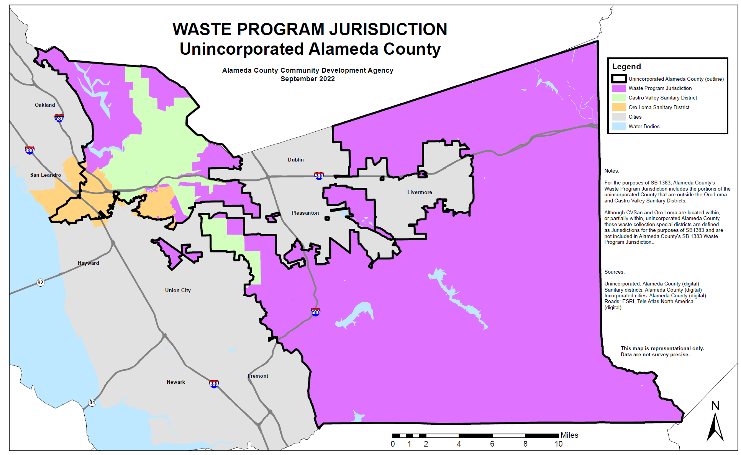
Background
Unincorporated Alameda County is largely served by two sanitary districts, Oro Loma Sanitary District & Castro Valley Sanitary District
Per SB 1383, the County’s Waste Program Jurisdiction is the unincorporated areas outside of the SD boundaries

Slide 9
Background
Both LSI and PGS offer SB 1383 compliant services under their recently amended franchise agreements in their respective cities.
Both haulers provide residential and commercial services. There are no MFD accounts identified in the Waste Program jurisdiction.
LSI and PGS are aware that we need to negotiate new contracts for mandatory 3 container services in all accessible parcels.

Slide 10
Background
Low Population Waiver
Rural parcels – Alternative Compliance Possibility
Route efficiency considerations
Inaccessible parcels

Slide 11
Background
CalRecycle-
The County is currently under a Corrective Action Plan with CalRecycle’s JACE branch for lack of SB 1383 hauler agreements. They are in support of our consultant project and are aware of our proposed timeline for compliance.

Slide 12
RFP Timeline
The RFP timeline reflects:
Written questions due Feb 8
Q&A issued Feb 15
Addendum issued Feb 15
Responses due Mar 6
Vendor interviews Mar 15-16
Selection Mar 23
Board approval April 25, with project start immediately after.

Slide 13
Negotiation Plan
The county recommends addressing the two primary haulers separately as these negotiations and services are completely independent of one another.

Slide 14
Project Timeline
Negotiations
Draft agreement review process
Public meeting presentation
Board approval and ultimately
Service rollout and the commencement of the required route reviews & recordkeeping.

Slide 15
Project Timeline
The timeline follows our one-hauler-at-a-time plan with as much overlap as is practical.
Ideally the LSI draft agreement would be ready for review in mid-June, and the PGS draft agreement ready in mid-August.

Slide 16
Hauler Overview - LSI
Recent Acquisition
Amend current agreement
Collection Zone 1
Densely populated
Rural
Equipment needs

Slide 17
Hauler Overview - PGS
No current agreement
Limited services in diverse areas
Equipment needs

Slide 18
Roles
County – Data, Introductions, Attend
Consultant – Leadership, negotiations, rates, draft agreements and present at public meetings

Slide 19
SLEB
Small Local Emerging Business (SLEB)
Must have SLEB certification or subcontract
See RFP for links to more SLEB info on GSA website

Slide 20
Bid Packet
RFP contains the county’s standard Bid Packet.
Read carefully for all submittal requirements

Slide 21
Evaluation Process
Two Stage Approach
Initial evaluation of the written proposal
2. Preliminary scoring to develop a short list of Bidders that will continue to the final stage of oral interview and reference checks.

Slide 22
Questions?

