Slide 1

EXPLAINING THE POOR RECORD OF REENTRY EMPLOYMENT PROGRAMS
April 2019
Alameda County Probation Department
Notes:
Introductions
Apologize if any of this information is repetitive

Slide 2
Explaining the poor record of reentry employment programs
01
Measuring the performance of employment-focused reentry programs
Notes:
Our goal for today is to offer some explanations as to why reentry programs focused on employment have such poor outcomes, and to suggest some alternatives ways of thinking about impact.

Slide 3
Explaining the poor record of reentry employment programs
02
Understanding the barriers to employment after incarceration
01
Measuring the performance of employment-focused reentry programs

Slide 4
Explaining the poor record of reentry employment programs
02
Understanding the barriers to employment after incarceration
01
Measuring the performance of employment-focused reentry programs
03
The unclear relationship between employment and recidivism

Slide 5
Explaining the poor record of reentry employment programs
02
Understanding the barriers to employment after incarceration
04
Refocusing on desistance as a goal and measure of impact
01
Measuring the performance of employment-focused reentry programs
03
The unclear relationship between employment and recidivism

Slide 6
America’s reentry crisis
SCALE AND IMPACT
Every week, 10,000 individuals are released from state and federal prisons
70 million
(1 in 3) people in the US have a criminal record
1/3 of these individuals never find employment
40% of formerly incarcerated individuals return to prison within three years of release
They survive by a combination of family and partner support, food assistance, public benefits, and illicit activities
Many become homeless
Notes:
[briefly touch on a few of these data points]
The scale and impact of this issue is so large that it warrants creative thinking and different approaches to finding something that works.
Unfortunately, so far, little has worked.

Slide 7
Reentry Employment Programs
MEASURING IMPACT
Randomized Controlled Trials
Participants randomly allocated to either the group receiving the treatment under investigation or to a group receiving standard treatment as the control group.
What makes a program evidence-based?
Employment does not reduce the likelihood of recidivism
Increasing employment through short-term subsidized jobs
does not lead to long-term unsubsidized employment
Notes:
“In order for something to be evidence based, it has to be evaluated over a duration to determine whether it achieves outcomes along specific performance measurements.’
We did a review of employment-focused reentry programs across the country, and found that while there were a lot of anecdotal claims about positive results, few programs were rigorously evaluated, and those that were, showed little success
The key performance measures that are typically used in evaluating reentry employment programs are:
subsidized or transitional employment during the program
unsubsidized employment, or employment on the open market, after the end of the program
Recidivism
Researchers using the highest standard of program evaluation, Randomized Controlled Trials, found that employment-focused reentry programs increase short-term subsidized employment, but in general, do not appear to have a significant or consistent impact on unsubsidized employment or recidivism
So, in other words, having a transitional job, does not lead to long-term workforce attachment, and having a job does not reduce the likelihood of committing a new offense following release

Slide 8
Employment barriers for formerly
Incarcerated individuals
INTERNAL BARRIERS
EXTERNAL BARRIERS
Job readiness, education, skills
Legal employment discrimination
“Leaving incarceration is most often a transition from prison to poverty… respondents’ median annual income was about half the federal poverty line, a striking level of extreme disadvantage…”
Bruce Wester, Homeward
Criminal thinking, prosocial network, self-identity
Racial employment discrimination
Mental and physical health; substance abuse disorders
Housing + transportation
Family support, professional contacts
Extreme poverty
Notes:
What are reentry employment programs up against in assisting formerly incarcerated individuals in finding lasting employment?
Released prisoners face a complex set of barriers to employment, both internal and external --
INTERNAL BARRIERS
Reentering citizens often lack education, skills, and work experience.
They suffer from physical and mental disorders that are exacerbated by life in detention
exhibit patterns of behavior that are at odds with workforce norms, which are shaped by living in a prison or jail environment
fractured relationships with their families
EXTERNAL BARRIERS
Returning citizens are some of the most impoverished Americans
And they return to low-income communities where there are few job opportunities
The few job opportunities that do exist are largely inaccessible to them due to legal employment discrimination.

Slide 9
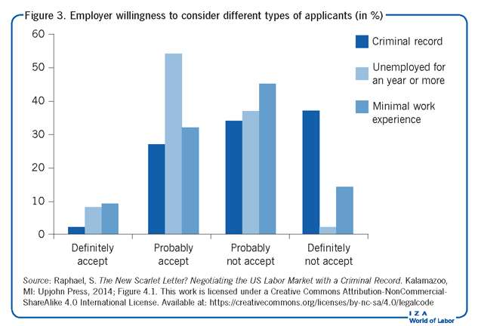
Employment barriers for formerly
Incarcerated individuals
Notes:
2014 study by Stephen Raphael -- almost no employers said they would “Definitely Accept” an applicant with a criminal record; almost 40% they would “Definitely not accept” such a candidate.
Employer preferences for applicants without criminal backgrounds do not violate federal law, but this legal employment discrimination has significant racial effects.

Slide 10
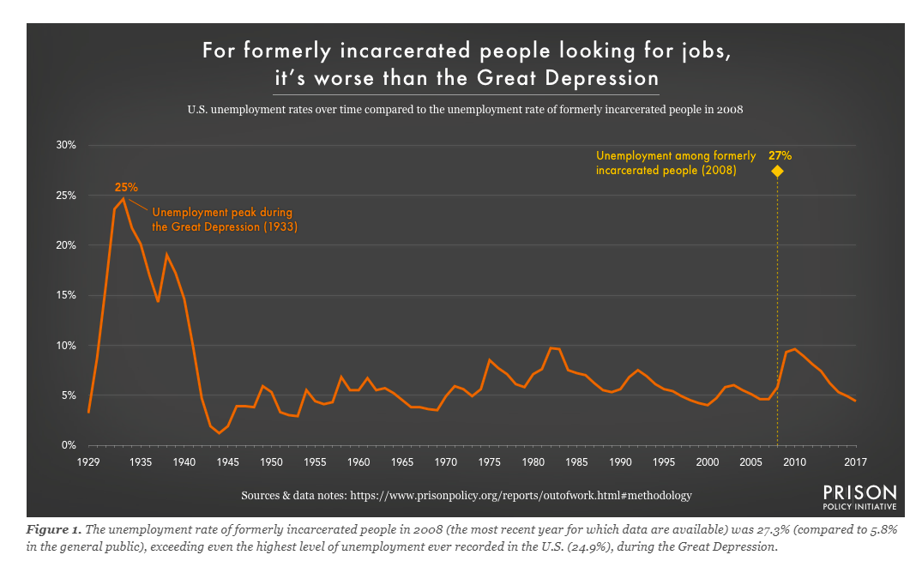
Employment barriers for formerly
Incarcerated individuals

Slide 11
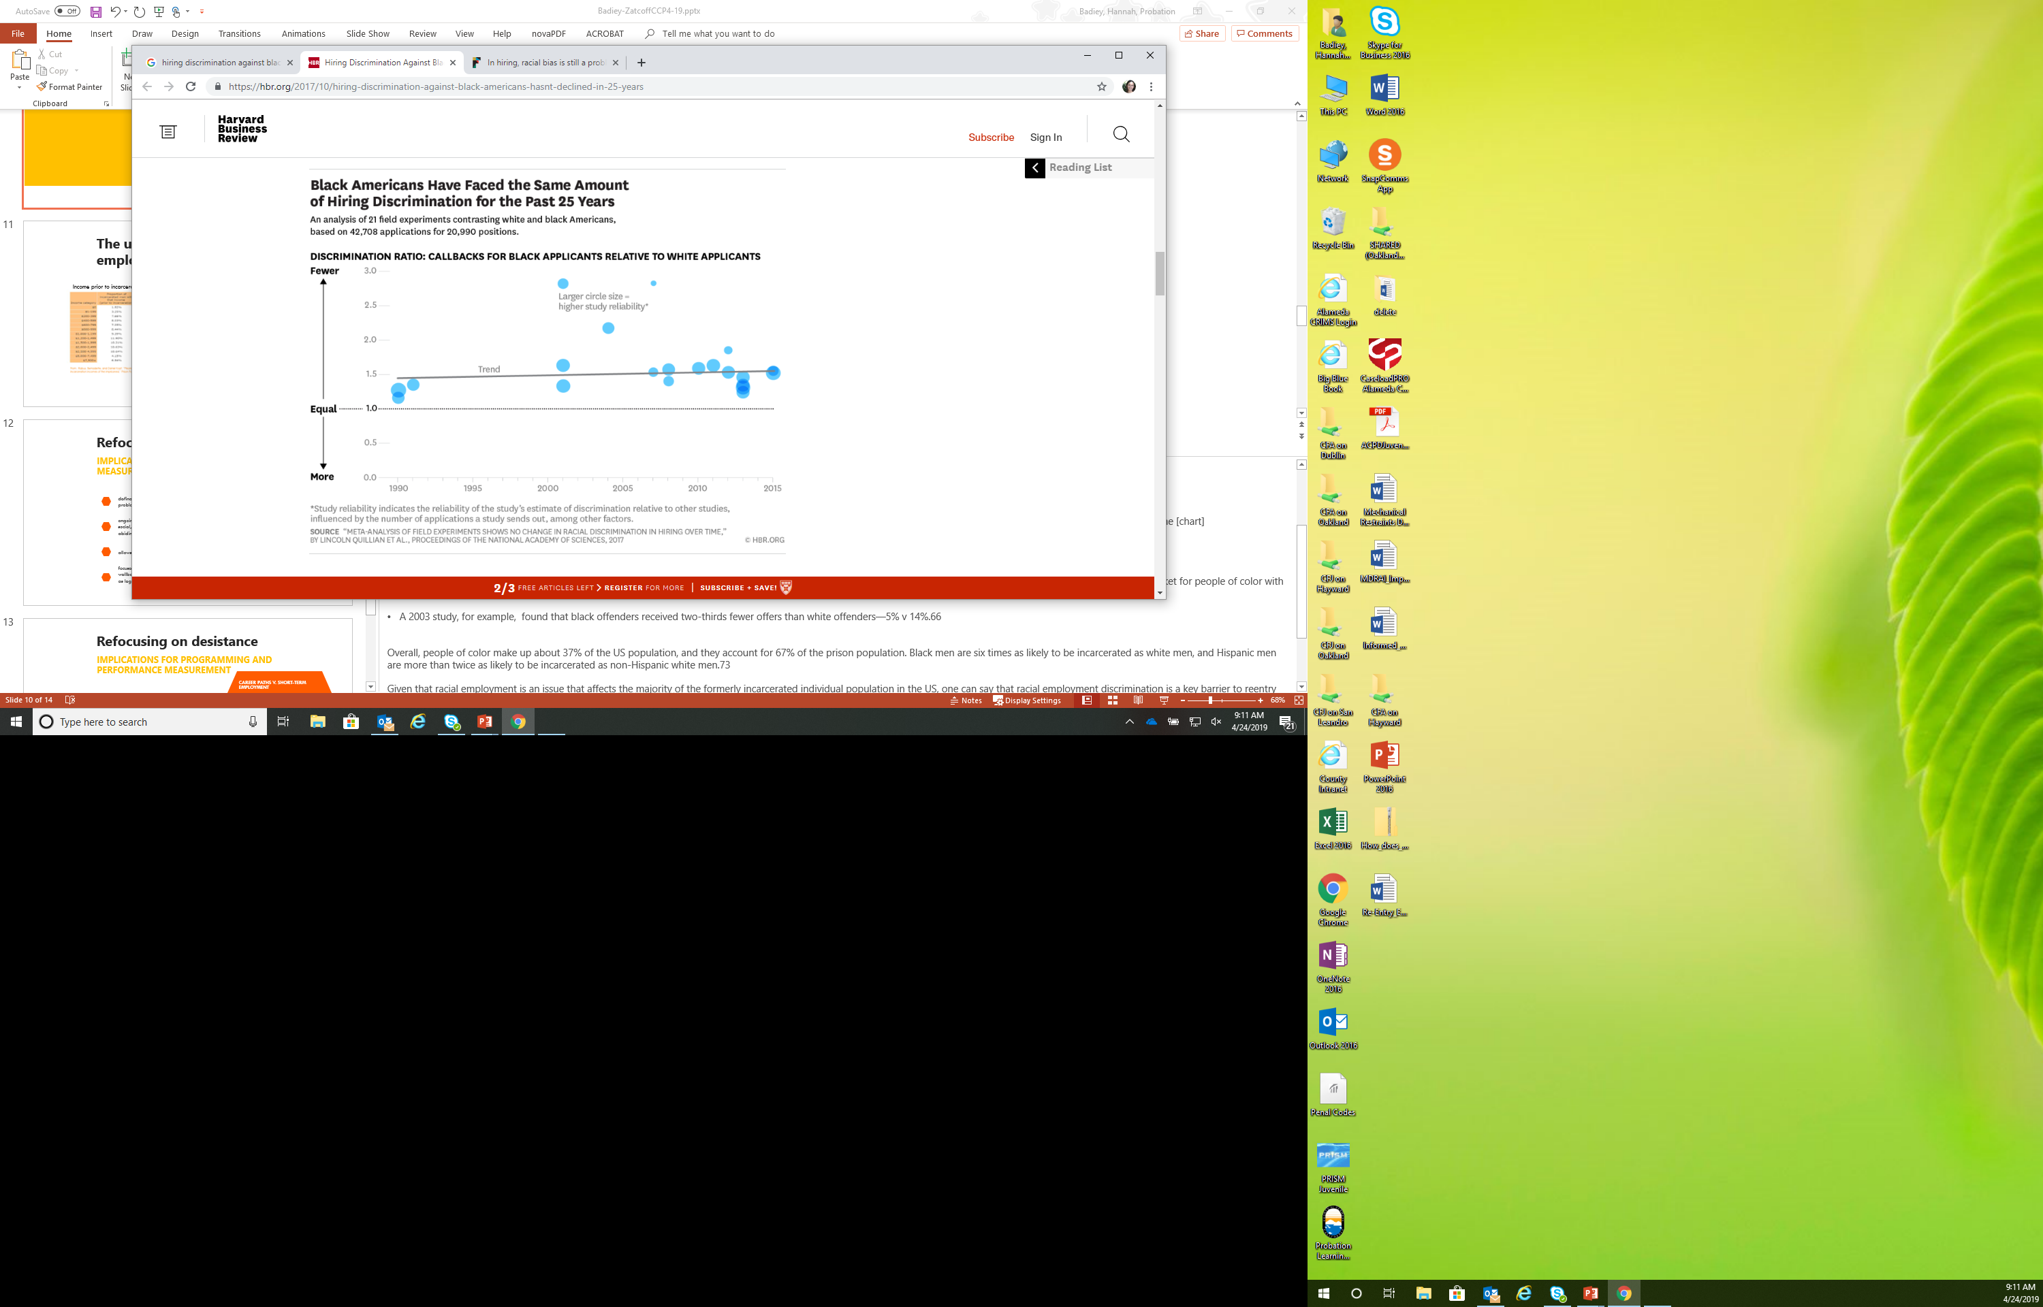
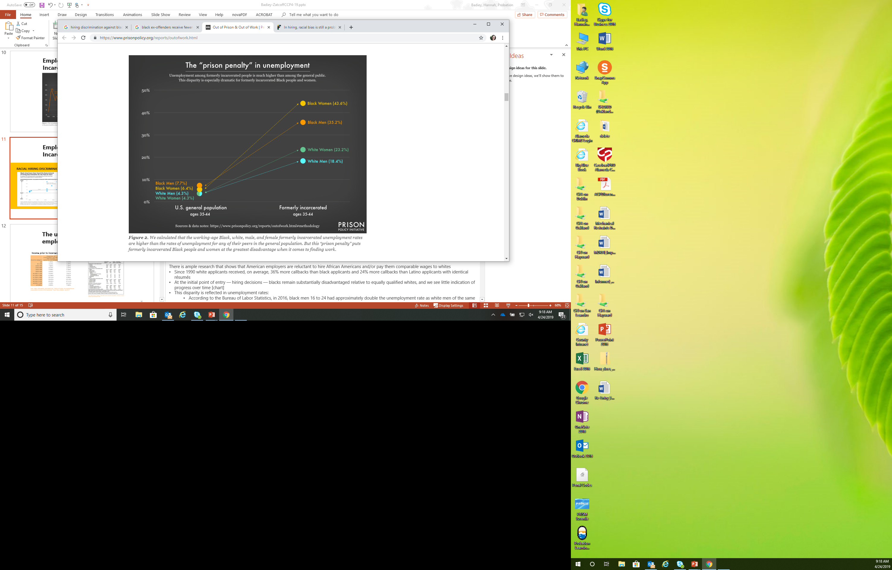
Employment barriers for formerly
Incarcerated individuals
RACIAL HIRING
DISCRIMINATION
THE ‘PRISON PENALTY’ FOR
BLACK APPLICANTS
Notes:
Not only do we know that employers are disinclined to hire individuals with a criminal record, but in fact there are myriad state laws that explicitly bar such individuals from specific professions and job categories.
EMPLOYMENT DISCRIMINATION AND RACE
There is ample research that shows that American employers are reluctant to hire African Americans and/or pay them comparable wages to whites
Since 1990 white applicants received, on average, 36% more callbacks than black applicants and 24% more callbacks than Latino applicants with identical résumés
We see little indication of progress over time [chart]
This disparity is reflected in unemployment rates -- According to the Bureau of Labor Statistics, in 2016, black men 16 to 24 had approximately double the unemployment rate as white men of the same age range (29.4% unemployment rate; 15.6% for white men 16-19. black men 20 to 24, 15.3% ; 7.9% for white men 20-24)
This racial employment discrimination is compounded for people of color with criminal records:
In one 2003 study, black offenders received two-thirds fewer offers than white offenders—5% v 14%. As the chart above shows, this has not changed much in 25 years.
People of color make up 67% of the prison population. Due to the racial characteristics of mass incarceration, racial employment discrimination is an issue that affects the majority of the formerly incarcerated individual population in the US, and therefore, employment discrimination against formerly incarcerated individuals can be considered a form of racial discrimination that effectively blocks people of color from the labor market.

Slide 12
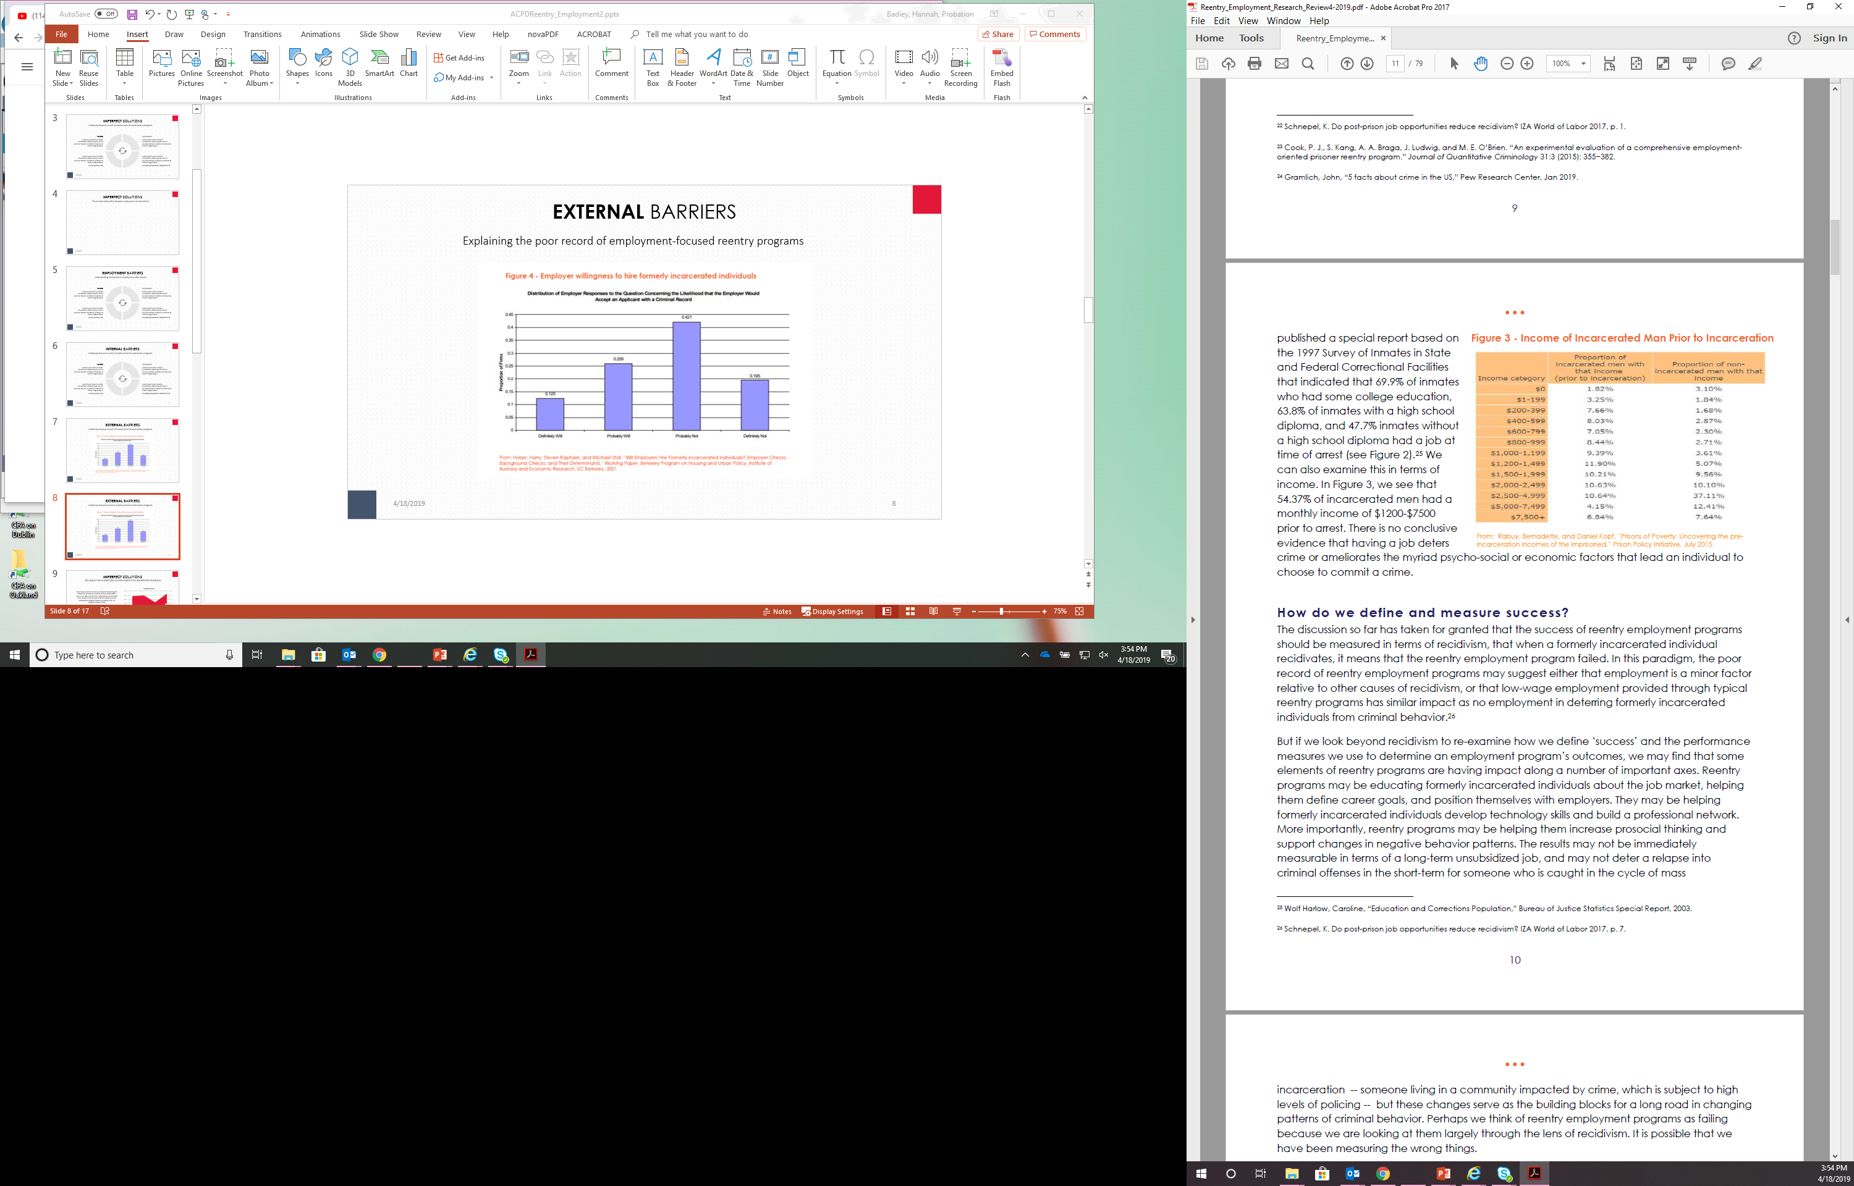

The unclear relationship between employment and recidivism
Income prior to incarceration
Employment at time of arrest
Notes:
It is in the context of such a system that reentry employment programs must operate:
barriers presented by the labor market are beyond their ability to impact in a 6-12 month timeframe.
a single job placement or retention does not eliminate the tenuous position in which reentry citizens find themselves in relation to the labor market.
The relationship between a job and criminal activity
Underpinning all reentry employment programs is the belief that finding employment will make a formerly incarcerated individual less likely to engage in criminal activity.
The thinking is that a formerly incarcerated individual will build social ties and professional networks through employment, which will deter them from criminal activities.
Although such arguments make intuitive sense, there is limited empirical evidence to support the claim that employment reduces recidivism.
In fact, the relationship between employment and recidivism is not at all clear.
First of all, many prisoners have a full-time job at the time of arrest – job/income [tables]
Perhaps we think of reentry employment programs as failing because we are looking at them exclusively through the lens of recidivism and job placement. It is possible that we have been measuring the wrong things
The problems with recidivism as a measure of impact are well known -- it not a measure of individual behavior, but rather a measure of how individuals are perceived and treated when they come into contact with legal authorities.
low-income minority communities, low-income people of color are statistically more likely to be subject to arrest and conviction.
Also, crime concepts evolve over time -- states downgrade some crimes from felonies to misdemeanors
Focusing solely on job placement may prevent us from addressing and seeing the processes that need to happen for a person to be successful in finding and keeping work that is meaningful and rewarding to them and can help lift them out of the cycle of poverty and criminality.
But if we look beyond recidivism and job placemen to re-examine how we define ‘success’ and the performance measures we use to determine an employment program’s outcomes, we may find that some elements of reentry programs are having impact along a number of important axes.
Reentry programs may be educating formerly incarcerated individuals about the job market, helping them define career goals, and position themselves with employers.
They may be helping formerly incarcerated individuals develop technology skills and build a professional network.
More importantly, reentry programs may be helping them increase prosocial thinking and support changes in negative behavior patterns.
The results may not be immediately measurable in terms of a long-term unsubsidized job, and may not deter a relapse into criminal offenses in the short-term for someone who is caught in the cycle of incarceration but these changes serve as the building blocks for a long road in changing patterns of criminal behavior.

Slide 13
Refocusing on desistance
SHIFTING THE CONVERSATION
Cognitive Behavioral Intervention (CBI)
defined as marked decrease or sustained absence from criminal/
problem behavior
ongoing change process, involving an interweaving of individual, family, social, and environmental factors, whereby individuals learn to be law abiding over time
allows for degrees of success and occasional setbacks
focuses on positive outcomes (e. g. social integration, community wellbeing, individual empowerment) not only as avenues for change, but as legitimate objectives in and of themselves
Notes:
Define desistance –
Marked decrease or sustained absence from criminal and/or problem behavior
Unlike the binary event of recidivism (success/failure), in a desistance framework, crime reduction is viewed as an ongoing change process involving an interweaving of individual, family, social, and environmental factors, whereby individuals learn to be law abiding over time.
many of these issues cannot be addressed in an isolated manner
a complex set of defining experiences –trauma, poverty, incarceration
ultimately is about rebuilding a life, including an individual identity and sense of personhood, family and social relationships, and a community.
How can we impact these areas?
One area that we know works is CBI, which has started to be used in reentry employment training.
Psychologically based interventions aimed to reshape thinking and reduce problem areas (i.e. antisocial thoughts)
Can be infused in employment programs to focus on thought-process behind getting a job, keeping a job, and the meaning behind a job

Slide 14
Refocusing on desistance
IMPLICATIONS FOR PROGRAMMING AND PERFORMANCE MEASUREMENT
CAREER PATHS V. SHORT-TERM EMPLOYMENT
GOOD JOBS V. JOBS
LIVABLE WAGES
CAREER COACHING V. JOB TRAINING
ALIGNING WITH LOCAL LABOR MARKET
ONGOING CAREER SERVICES
EMPLOYER ENGAGEMENT/EDUCATION
COMMUNITY PARTICIPATION/ VOLUNTEERS FROM BUSINESS COMMUNITY
APPRENTICESHIP PROGRAMS
RACE + CULTURAL COMPETENCY
Changing mindsets
Focusing on long-term goals
Holistic approach
Identity and belonging
Notes:
Thinking in terms of desistance has implications for programming and performance measurement.
What might this look like as specific programming elements?
Helping change someone’s attitudes about work, employers, and the workplace. About their own abilities and about the future.
Focusing on long-term career goals rather then a job in the short term –
helping clients define a path and steps to get there (whether that is acquiring skills, training, mentorship, contacts, etc; or improving their health and relationship with their family)
Holistic approach to job readiness – you can place someone in a job, but if their family life is in disarray, if they are struggling in other areas of their life, the job won’t stick – it won’t be sustainable.
It means viewing work as central to how someone sees themselves. Helping someone see themselves as a working person, and taking pride in their work.
Here the importance of building relationships with the local business community are key, because it takes time to change how someone sees themselves, and their abilities, as well as how they see employers and feel about work.
What would you measure? You could….
Career goals, plan to achieve them
Self-assessment of abilities, capabilities
Identify sources of mentorship, support, guidance
Family, community improvements, improvements in life stability
How someone feels about work
IN BOX
Rather than lowering our expectations, we need to raise the bar in which these programs seek to achieve, and in doing so expand our expectations for what is possible for our clients.
To be able to combat the barriers confronting individuals with criminal records, reentry programs must train and prepare ex-offenders not just for jobs, but good jobs.
They must think in terms of career paths, not short-term employment.
They must offer wages above minimum wage in jobs that align with a client’s career goals and set them on a path that matches with their objectives.
They need to identify viable and promising career tracks that match local labor market offers in order to help individuals transition into a new reality and begin to be able to see themselves in a new future.
They should provide ongoing services beyond the scope of most reentry programs, because six months is not enough to overcome the negative behavior patterns acquired in prison, or to remove the massive barriers that stand in the way of second chances.
They have to offer high-quality professional services tailored to individuals, which take into consideration their individual characteristics and histories, their families, and their communities, in order to help individuals realize their maximum potential.

Slide 15
“Policy researchers and policymakers often reduce ‘success’ to the avoidance of a new arrest. The focus on recidivism highlights the burden that reentry might impose on the rest of us. Instead of emphasizing recidivism, I view a successful transition from prison as the attainment of a basic level of well-being consistent with community membership. This view of success after incarceration captures something of what Irwin called the ‘dignity, fulfillment, [and] achievement of life goals.”
Bruce Western, Professor of Criminal Justice Policy and Sociology, Harvard University; Co-Director, Justice Lab, Columbia University
Homeward; Life in the Year After Prison (New York: Russell Sage, 2018)
THANK YOU
Naseem Badiey, MPhil, PhD
Probation Specialist, Research and Evaluation
hbadiey@acgov.org
Tyler Zatcoff, MPA
Probation Specialist, Evidence-based Practices
tzatcoff@acgov.org
Notes:
We will leave you with this quote by Bruce Wester, who is a Harvard professor, and open it up for questions.
THANK YOU!

Slide 16
Employment Research Sources:
https://hbr.org/2017/10/hiring-discrimination-against-black-americans-hasnt-declined-in-25-years
https://www.prisonpolicy.org/reports/outofwork.html
https://www.bjs.gov/content/pub/pdf/ecp.pdf (Table 14)
https://www.prisonpolicy.org/reports/income.html (Figure 7)
https://research.upjohn.org/cgi/viewcontent.cgi?article=1244&context=up_press (see pages 44-45)

